Slide 1
Writing A Resume
Georgia Highlands College

Slide 2
What is a Resume?
Definition: A resume is a brief account of an applicant’s background, skills, and accomplishments.
Purpose: The goal of any resume is to get the applicant an interview.
Importance: a clear, scannable, and concise resume will get an employer’s attention.

Slide 3
How Do We Write a Resume that Will Get Us Noticed?
Major Considerations
Format
Sections

Slide 4
Format
Format is essentially the way something is arranged or laid out.
Resume Format Expectations:
No more than one page in length!
Margins between 0.5 inch and 1 inch.
Make the most out of the space on the document (avoid too much or too little white space)
List content in reverse chronological order

Slide 5
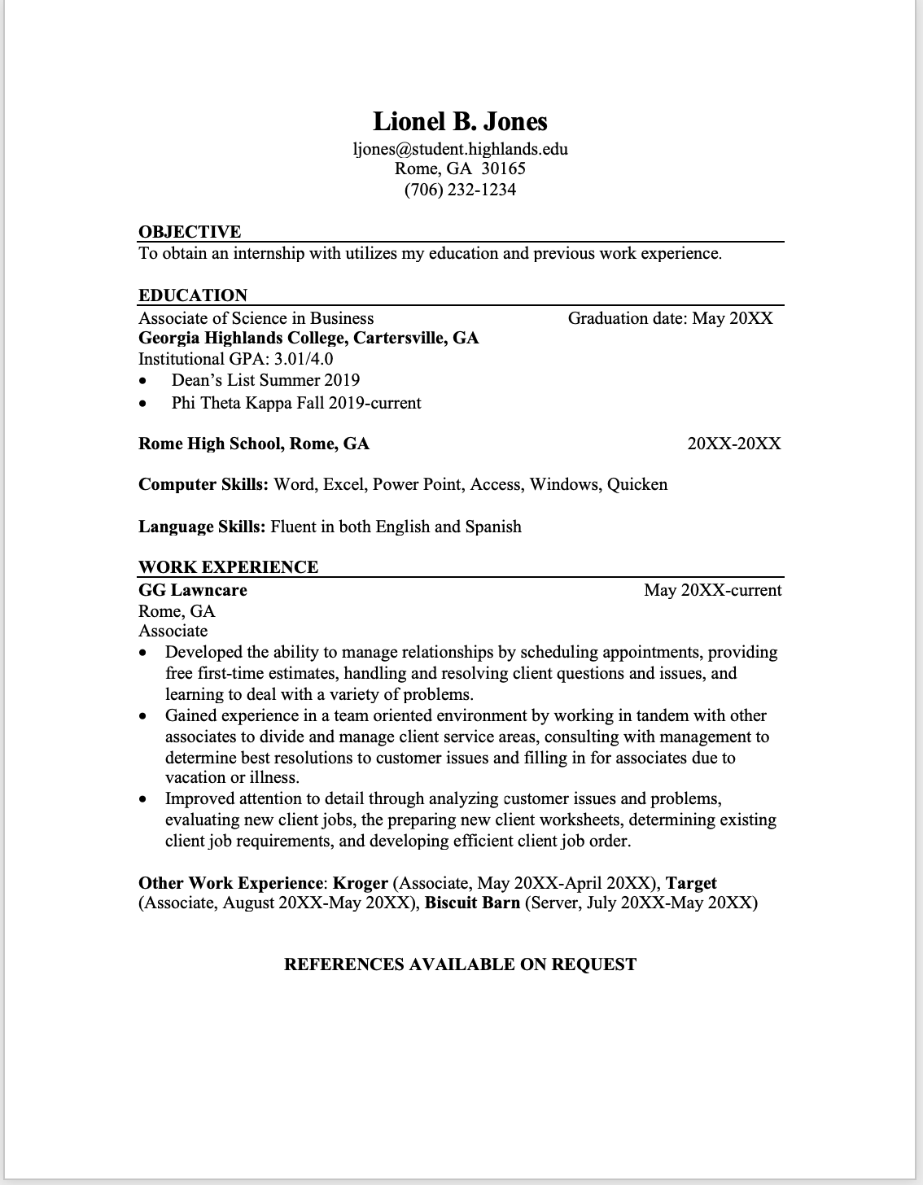
Sections:
Sections to Include:
Header
  Contact Information
Professional Summary
Education
Professional Experience
Professional Skills

Slide 6
The Header
The Header should include your name, and your most recent contact information.
First Name Last Name
Email Address
Phone Number
Location (City and State)
Tips*
Make a professional email that includes your name, not a username.
If you have a LinkedIn, include a link to your profile in your header.

Slide 7
Professional Summary (Objective)
A professional summary is a brief summary of your skills, expertise and career objective.
Include the title of your current position or expertise
  "English Teacher" or "Digital Marking Specialist"
  "Passionate English educator with four years of experience in a post-secondary education setting. Seeking to use knowledge of writing process, high-impact teaching practices, and literary works to improve student success rates in Imaginary University."

Slide 8
Education
In this section include your degree information
Program Name/ Degree Title
  Bachelor of Arts in English Literature
University Name
Graduation Year
Optional Sections:
GPA
Honors
Academic Achievements/ awards
Minor

Slide 9
Professional Experience
Dates Employed
Job title/position
Company name/ location
Description of job responsibilities (start sentences with action verbs)
Key Achievements (list quantitative achievements or honors)
Exceeded sales team KPIs by 30%+ for 3 months straight.
Generated over $24,000 in sales in 1 month.

Slide 10
Skills
Critical Thinking
Hard Skills- Measurable Abilities
Program/Software Knowledge
Soft Skills – Personal Skills
Special Skills
Leadership
Management
Communication
Certifications
Include hard and soft skills:

Slide 11
Optional Sections
Languages
Volunteering experience
Certifications and awards
Publications

Slide 12
Resume Writing Tips!
Be consistent with your formatting- consistent formatting makes your resume scannable!
Length & Margins - One page and margins no smaller than .5 inches.
Watch your verb tenses - If you are still currently in a position, use present tense. If the position was in the past, use past tense.
Voice- Avoid first person pronouns.
Keep it to one page.
Proofread!

Slide 13
Create Your Own!
If you have a resume...
If you do not...
Get in groups of two or three
Trade resumes
Read to see if the it has a scannable format and appropriate sections
Give your partners constructive feedback.
Trade back and revise!
Using the template provided, create a rough draft of your resume
When you are done, get in groups
Read for a scannable format and appropriate sections
Give constructive feedback
Trade back and revise!

Slide 14
Work Cited
Kurtuy, Andrei. “How to Write a Resume in 2021: Beginner's Guide.” Novorésumé, Novorésumé ApS, 2021, https://novoresume.com/career-blog/how-to-write-a-resume-guide.

