Slide 1
Dog Daycare and Boarding Business Budgets

Slide 2
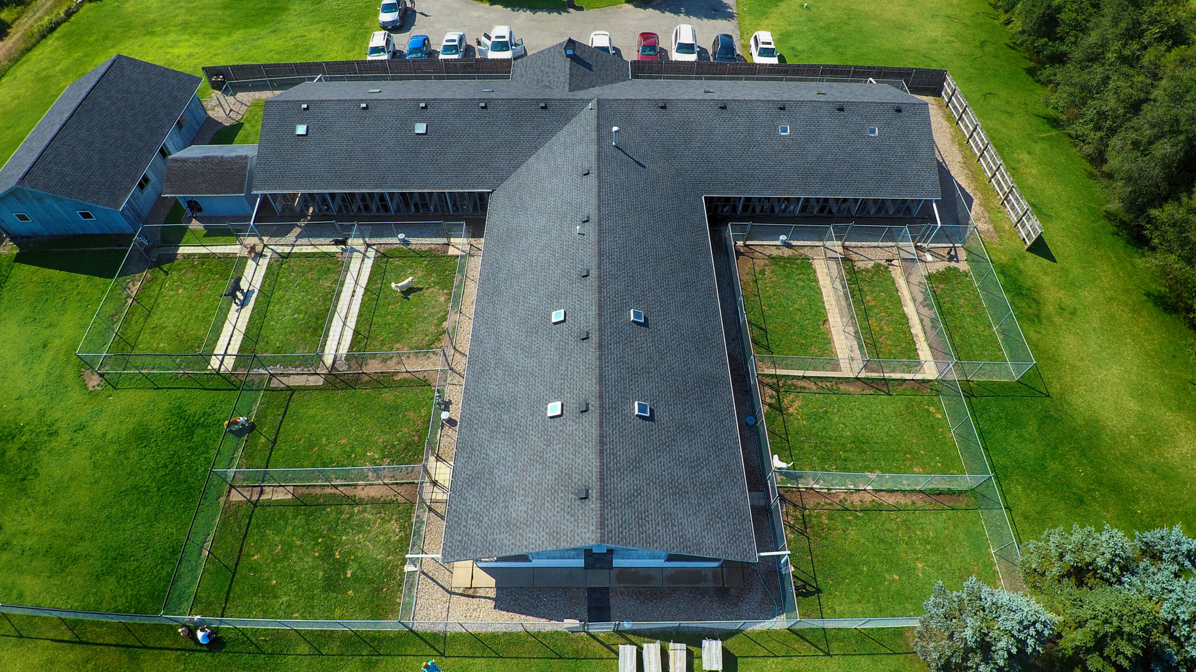
Facility Variables
Size Needed – Max Occupancy
General Location
Hours & Staff
Potential Upgrades – Floors and Fence

Slide 3
How Much Space Do I Need?
Imagining my ideal building and layout
Consideration to staff and dog's needs
Research on average sized rooms and desired enclosure size
Total Needed Building Size:
2,995 sq ft
Staff / General |  |  | Play Yard
Bathroom | 40 sq ft |  | 15 Small Dogs | x 40 sq ft per | 600 sq ft
2nd Bathroom | 40 sq ft |  | 15 Large Dogs | x 70 sq ft per | 1,050 sq ft
Laundry | 50 sq ft |  |  |  | 1,650 sq ft
Bathing Area | 50 sq ft |  | Enclosure
Storage | 25 sq ft |  | 15 Enclosures | 4x4 | 240 sq ft
Kitchen | 160 sq ft |  | 15 Enclosures | 4x6 | 360 sq ft
Office | 100 sq ft |  |  |  | 600 sq ft
Reception | 160 sq ft
Breakroom | 120 sq ft |  | Total For Dogs |  | 2,250 sq ft
Total for Staff | 745 sq ft

Slide 4
Determining Facility Costs
Can be difficult to guestimate for the ideal building location and costs
Average Rent
Used real estate websites to get average for cost/sf/year and general property information
Areas such as Marietta, Kennesaw, Woodstock : $12.50/sf/year
Farther from City such as Cummings, Gainsville: $7.25/sf/year
Average Electric and Water Bill:
Energy management websites: Commercial Utilities $2.10/sf/year
Water management websites: Non-Residential $5.21 per 1,000 gallons/monthly
Overall Estimate for Utilities: $500 monthly
Notes:
Real Estate Website: Loopnet, PropertyShark, showcase.com
Electric and water bill: Energy Information Administration 2021-2022 Average Commercial Electric Bill, Cobb Water Rates

Slide 5
So How Much is Rent Going To Cost?
I will be using 3,000 sq ft for further calculations as it is an easier number to use and to adjust for potential use
Rent in Marietta or Surrounding: $37,500/year or $3,125/monthly
Rent in Cumming or Surrounding: $21,750/year or $1,812.50/monthly
Using $2,000 monthly rent for further calculations

Slide 6
Well, I will probably need Insurance
Progressive Commerical 2021 Median Costs
General Insurance: $65
Business Owners Policy: $68
Workman's Comp Liability: $111
Professional Liability: $300
Total Insurance = $300 Monthly

Slide 7
How about a Business License?
For the State of Georgia, the current rules for 2023:
Kennel License Fee – based upon the holding capacity
Capacity for 21-40 pets: $200.00 fee
The License is Valid for one year
$200 Fixed Yearly Cost

Slide 8
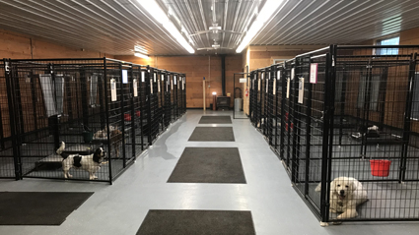
Where am I going to put 21-40 dogs?
K9-kennelstore.com
Enclosure Count: 30
Full Stall Dog Kennels / Welded Wire and Metal
15 'Small' Enclosures (4x4) = $9,654
15 'Large' Enclosures (4x6) = $9,843
30 Heavy Duty Enclosures = $19,497 Initial Cost
Notes:
K9-Kennelstore is a very popular business with safe, tough, and durable dog enclosures ranging from a variety of sizes and styles

Slide 9
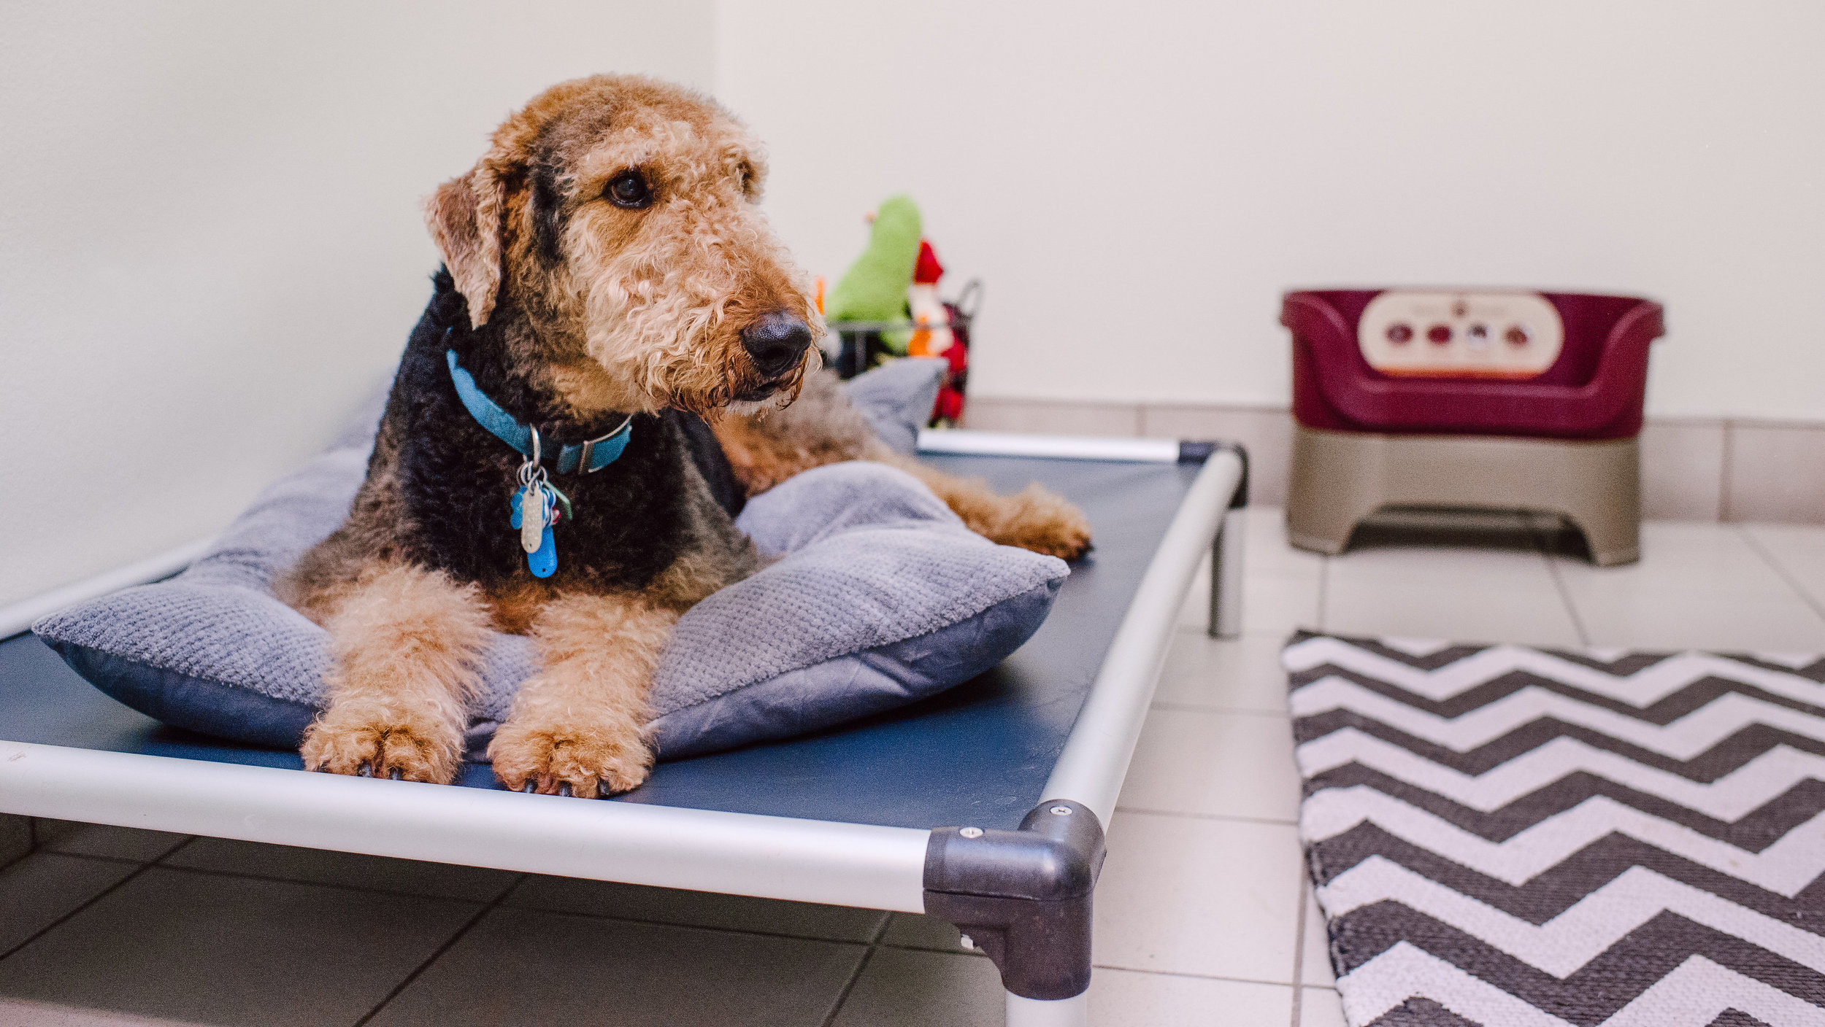
Initial Necessities
Heavy Duty Vinyl Dog Beds - $87.95 per x 15 beds = $1,319.25
Stainless Steel Pet Bowls – 60 32oz, 4 96oz = $139.36
Playground Equipment – Starter Kit = $1,850
Basic Cleaning – Trash Cans, Mop Buckets, Poop Scoops ect... - $500
Total Costs = $7,576.11 initial cost
Notes:
Karunda Dog Beds – High Quality Aluminum or PVC w/ Heavy Duty Vinyl
Bowls: petedge.com , amazon, walmart
Equipment: puppyplayground.com
Cleaning – home depot and lowes

Slide 10
Facility Upgrades
Rolled Rubber Flooring - $2.50/sqft x 1,650 sq ft play yard = $4,125
Outside Space Fencing Estimate = $4,844
Estimate of $8,969 in Basic Facility Upgrades Initial Cost
This Photo by Unknown author is licensed under CC BY-SA-NC.
Notes:
Allied Products LLC – Rolled Rubber Industrial Flooring, comfort and durability
Fencing- Lawn Care Websites

Slide 11
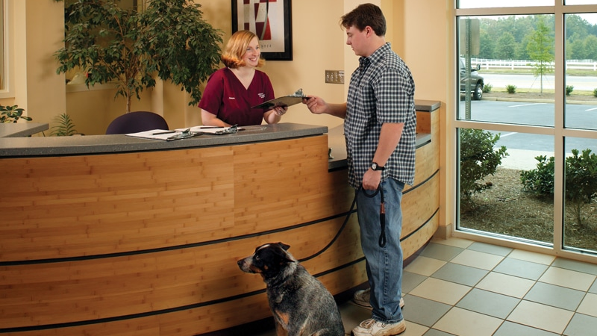
How about for the staff?
Facility and Front Office Equipment
Computer & Monitor = $500
New iPad = $325
New TV = $975
Printer = $350
Basic Office Supplies = $150
Lorex Camera System = $1,649.99
Total Costs = $3,949.99 initial cost
Notes:
General Google Searches
Computer & Monitor for Front House
New iPad – for Back House
Printer and basic office supplies, pens, paper, ink, ect...
Lorex camera system – front and back house, 12 cameras with video recorder

Slide 12
I will need to pay my staff....
Payroll Break Down |  |  | Monthly
2 Mangement/Leads | $17 per hour | 40 Hour Work Weeks | $5,440.00
2 Kennel Tech's | $13 per hour | 40 Hour Work Weeks | $4,160.00
 |  |  | $ 9,600.00
 |  |  | $1,920 | (20%; social security, Medicare, unemployment…)
 |  |  | $11,520.00
2 Mangement/Leads | $17 per hour | 40 Hour Work Weeks | $5,440.00
2 Kennel Tech's | $13 per hour | 40 Hour Work Weeks | $4,160.00
2 Kennel Tech's | $13 per hour | 24 Hour Work Weeks | $2,496.00
 |  |  | $12,096.00
 |  |  | $2,419.20 | (20%; social security, Medicare, unemployment…)
 |  |  | $14,515.20
Notes:
Including Myself
Potential for Tips for employee pay
Low volume periods versus high volume periods
What is the 20%??

Slide 13
Additional Costs
Software – Paw Partner = $100 Monthly
Marketing – 2%-5% of Revenue = $300 Monthly
Supplies – Chemicals, Cleaning, Perishables = $350 Monthly
Notes:
Software used for client and pet management, reservation management, staff management. Potential for Retail items to be sold
Marketing – facebook ads, other online ads, magazines, ect..
Supplies – Monthly necessities, daily chemicals, cleaning supplies such as dish soap, sponge, gloves, trash bags, ect...

Slide 14
Expense Budget
Fixed Monthly Expenses
Insurance | $300
Rent | $2,000
Software | $100
Variable Monthly Expenses
Utilities | $500
Marketing | $300
Supplies/Misc. | $350
Payroll | $14,515
Total Monthly Expenses | $18,065
Notes:
What is an expense?
Outflow of Money, -18,065 a month
Fixed Expense – cost will stay the same month to month
Variable expense- varies month to month dependent on occupancy rates, staff needed, utilities being used, ect...

Slide 15
Capital Expenditures
Capital Expenditures
Cash Flows From Investing Activities
Enclosures | $(19,497)
Play Equipment | $(2,000)
Dog Beds | $(1,319)
Food & Water Bowls | $(140)
Office Equipment | $(975)
Cleaning Supplies | $(500)
Camera System | $(1,650)
Facility Upgrades | ($8,969)
Total | $(40,000)
Notes:
What is a capital expenditure?
Money invested into a company for a fixed asset. In comparison to an expense is an outflow of cash for overhead or operating purposes.
Capital expenditures are major purchases that will be used beyond the current accounting period in which they’re purchased. Operating expenses represent the day-to-day expenses designed to keep a company running

Slide 16
Putting it all Together
Insurance | Month 1 $300 | Month 6 $300
Rent | $2,000 | $2,000
Utilities | $500 | $500
Software | $100 | $100
Marketing | $300 | $300
Supplies / Misc. Expenses | $350 | $350
Payroll | $11,520 | $14,515.20
Startup Costs (One Time) | $40,000
Total Monthly Expenses: | $55,070 | $18,065
Notes:
Expense Report – Does contain the Capital Expenditure Cost for an Initial Startup Cost

Slide 17
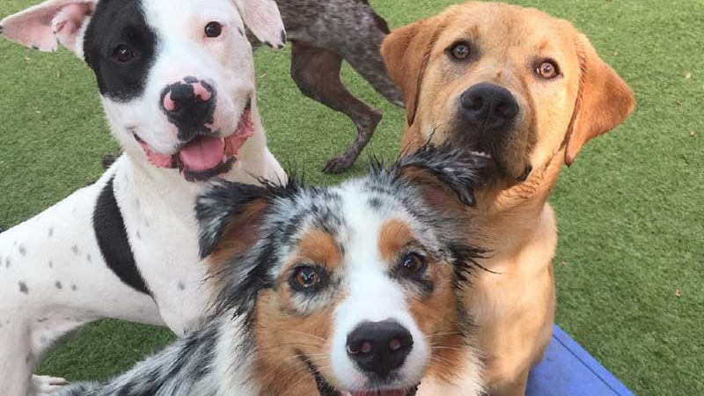
Calculating Potential Revenue
Boarding Only, or Boarding and Daycare?
Determining Pricing, 2 Enclosure Sizes
Small 'Suite' - 4x4 Enclosure - $40 Per Night
Large 'Suite' - 4x6 Enclosure - $50 Per Night
How many dogs will I have in my FIRST month?
How fast do I expect my business to grow per month?
Notes:
Difficult to determine. Imagining starting as a small-scale business with no reputation

Slide 18
Boarding Only
Boarding and Daycare
Notes:
Revenue Statement

Slide 19
Breaking Even
Monthly Expenses | $18,065
Divided by Boarding Rate | $45
# of Dogs in One Month | 401.4444444
Divided by 30 Nights | 30
Average Dogs Per Night | 13.38148148
Monthly Expenses | $18,065
Divided by Daycare Rate | $25
# of Dogs in One Month | 722.6
Divided by 30 Days | 30
Average Dogs Per Day | 24.08666667
Monthly Expenses | $18,065
Divided By Average Rate | $35
# Of Dogs in One Month | 516.1428571
Divided By 30 Days/Nights | 30
Average Dogs Per Day/Night | 17.2047619
Notes:
Breaking Even in 1 Month and 30 days
Break Even for boarding is about 13 dogs and to turn a positive cash flow quicket, I need to include daycare
Average for Daycare & Boarding to break even in 1 year is 6,192 Dogs

Slide 20
Income Statement – Boarding Only

Slide 21
Income Statement – Boarding & Daycare

Slide 22
Breaking it down...
Boarding only yearly cash flow remains negative for the first year
Boarding and Daycare turn a positive yearly cash flow after 6 months
Overall turn a profit faster with Boarding and Daycare
Potential of a second year in business, boarding will reach a yearly net profit
What did this project teach me?
Notes:
Explain difference in cash flow and net income... "cash flow is more important, because cash is what pays the bills"

