Slide 1
The Honors
Program
at GHC
Visit: honors.highlands.edu
Contact: honors@highlands.edu
Dr. Steve Stuglin
sstuglin@highlands.edu

Slide 2
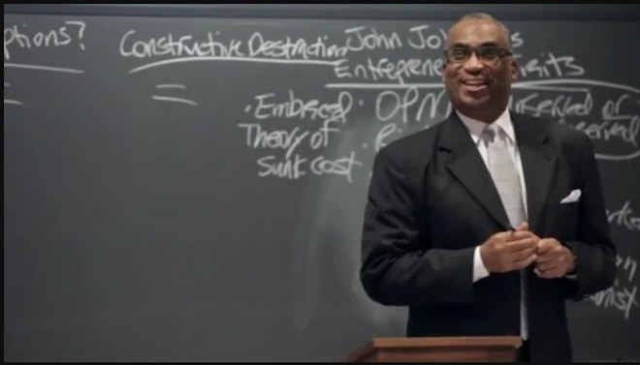
Why Honors?
Instructors: - to help out students!
- to have a chance to work with passionate
and bright students on a research project
- to reengage with some of the higher order content we all trained with but don’t utilize as much as we like in our intro courses

Slide 3
Why Honors?
Students: - to help distinguish themselves!
- challenge themselves!
- to have a chance to engage with higher order content, learn new methods, refine and practice research skills
- to get a jump on the kind of work they’ll be doing in upper level and grad courses

Slide 4
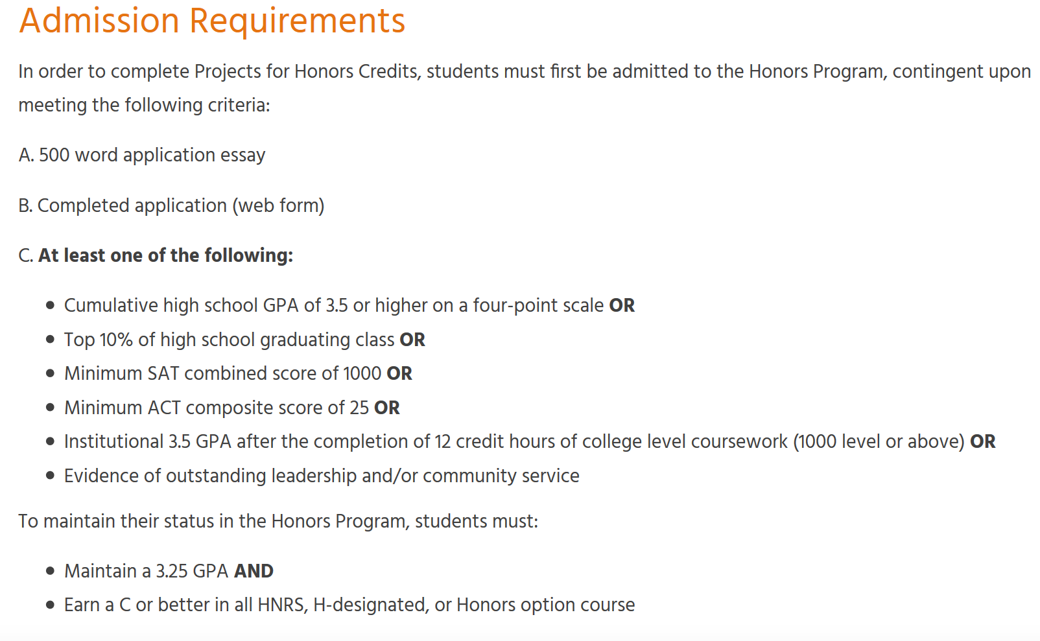

Slide 5
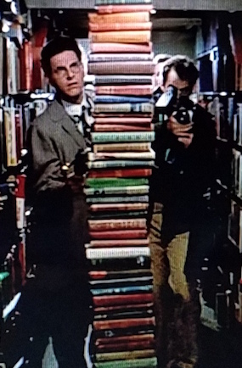
Honors Credits?
1. YOU tell your students about Honors
2. Interested students apply
3. HD/HAC review app, deny or accept
4. Student identifies course/instructor
5. Student/Instructor discuss ideas
6. Student/Instructor complete contract
7. Student completes project
8. Instructor approves project
9. Project and Final Report submitted
10. HD/HAC review & return or accept
11. B or better in course now earns Honors Credit -> Registrar

Slide 6
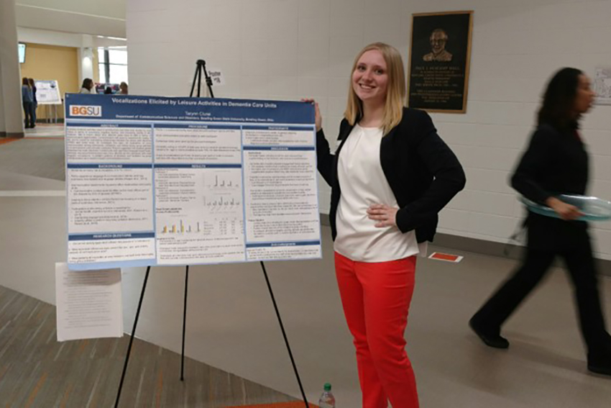
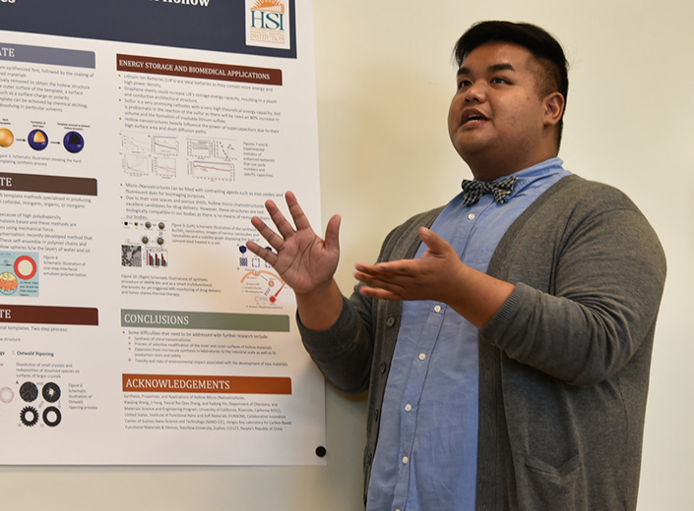
YOU can help our students by
participating in the Honors Program.
1. Tell your classes about Honors.
2. Be a Mentor for Honors Projects.
3. Direct questions to honors@highlands.edu

Slide 7
Being a Mentor means projects. What should they look like?
Quality, not quantity.
Depth, not breadth.
Tailored, not prefabricated.

Slide 8
Being a Mentor means projects. What should they look like?
Format based on preferences from you and student; negotiable
Research Project Parallel to Existing Project Prepared Presentation Meta Research Project Class Lead/Lecture Archival Project Demonstration of Principles Problem Resolution Exploratory Creative Project Controlled Experiments Oral History Investigative Project Website Creation Multimedia Creation Classroom Demonstration Targeted Informatory Curated Experiences
Performance Project …open to other ideas!
Co-op Project w/ NGO/NPO

Slide 9
Being a Mentor means projects. What should they look like?
Student
A project focus and format we’re both happy with, can deliver on, and which demonstrates academic rigor
Interests
Formats
Mentor

Slide 10
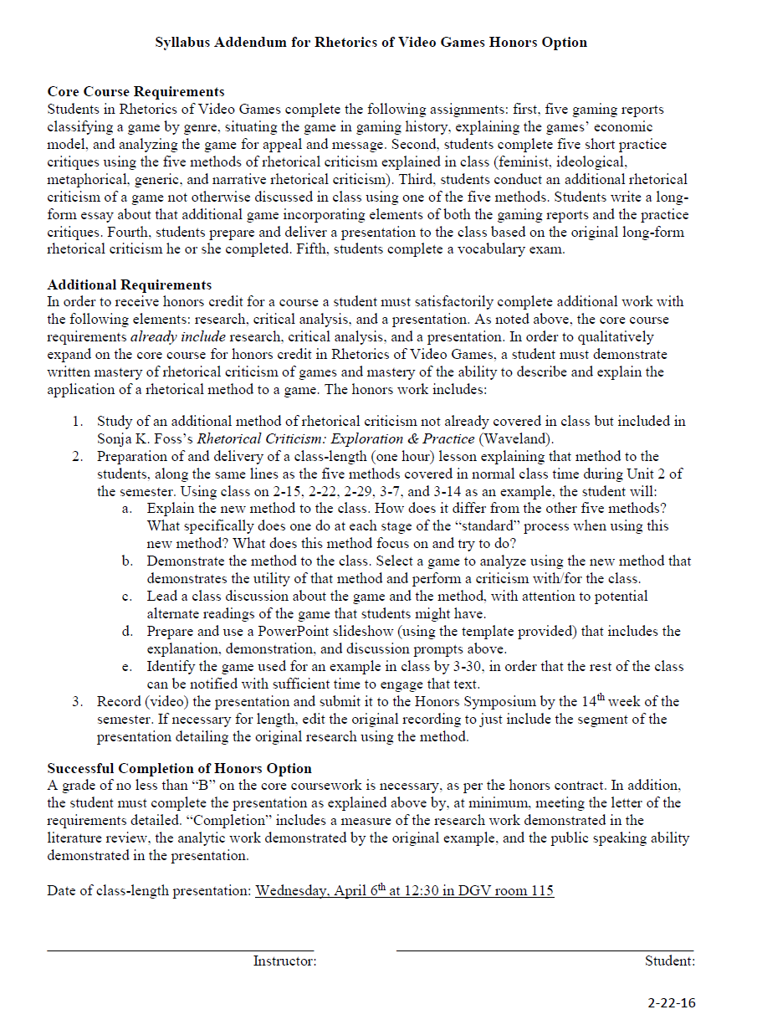
Let’s Build a Project!
Holly the Honors Student 19 years old 2nd semester
in your 1000 level course
this is 1st honors project
pathway: Biology wants to study whales
worried about climate
OK with public speaking Decent prose Technical APA style OK all-online this semester

Slide 11
YOU can help our students by
participating in the Honors Program.
1. Tell your classes about Honors.
2. Be a Mentor for Honors Projects.
3. Direct questions to honors@highlands.edu

Slide 12
Thank you. Questions?
Dr. Steve Stuglin
sstuglin@highlands.edu

