Slide 1
June 3 thru June 6
Southern Fried
Chicken Shaker
Salad
$5.99
Combo with a litter of Water
$7.00
Notes:
Font: Calibri
Size: 24pt–60pt

Slide 2
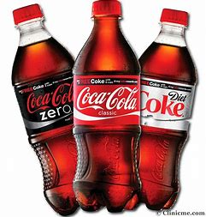
Buy
2
20 oz bottle Soda
$2.50
1
20 oz bottle Soda
$1.40

Slide 3
Community Coffee’s
Iced Signature Coffee
$2.99
16 oz cup
Dunkin Donut
Iced Coffee Bottles
$2.99
Notes:
Font: Calibri
Size: 24pt–60pt

Slide 4
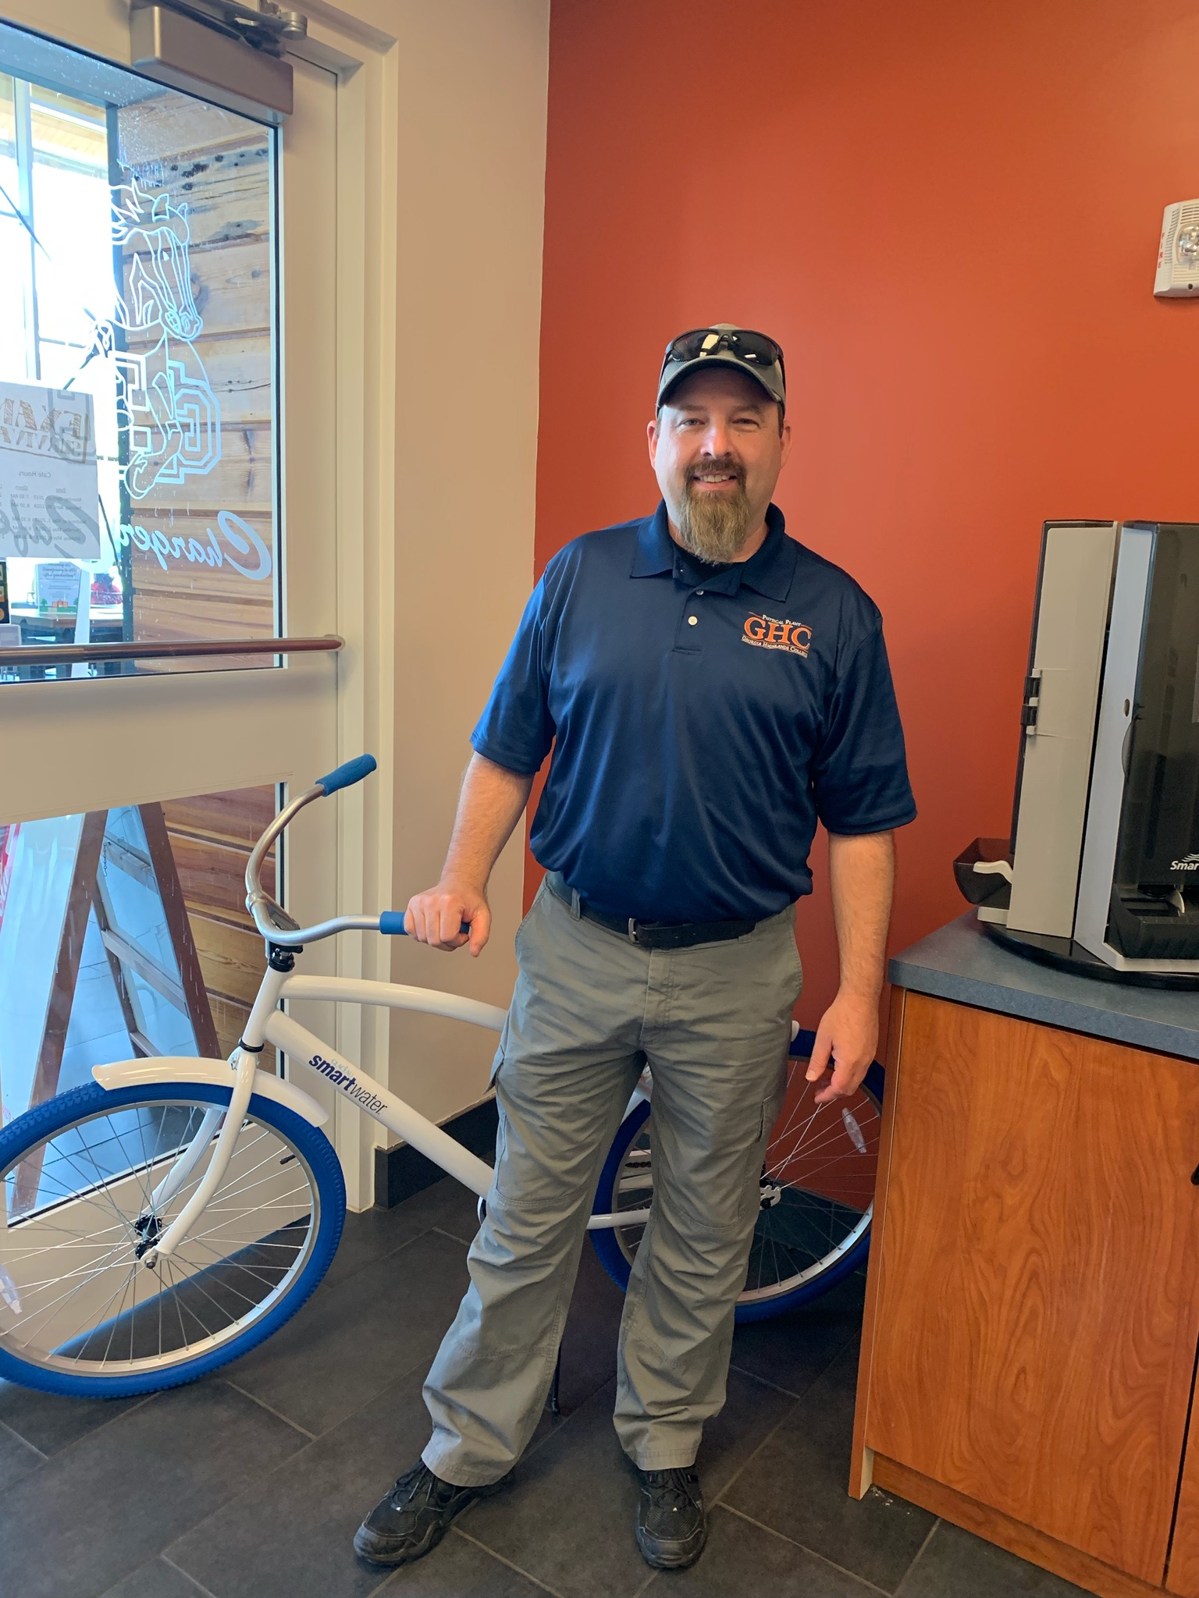
Bike Give Away
Congratulations to Mike Smithson our winner!!!
Notes:
IMPORTANT!
Please pay attention to the formatting of the menu and following these guidelines.
Menu Item Title: Use the font named CENTURY GOTHIC with size 24pt and should all be in UPPERCASE.
Menu Price: Use the font named CENTURY GOTHIC with size 24pt.
Menu Description: Use the font named CENTURY GOTHIC with size 20pt, Italicized and Sentence Case.

Slide 5
Charger Cafe Hours June 3, 2019 Thru August 1, 2019
Monday Thru Thursday
11:00 am to 1:30 pm
Catering is always available
Contact: Chad Welborn
chad.welborn@aladdinfood.com
Notes:
5

