Slide 1
Financial Aid 101
Presented by Lisa Garrett
Senior Financial Aid Counselor

Slide 2
Students want to go to college. . .
But how do you pay?
There are several ways:
Federal Financial Aid
State Scholarships and Programs
Institutional Scholarships
Private Loans

Slide 3
What federal aid can you get?
Pell Grant
FSEOG (Federal Supplemental Educational Opportunity Grant)
Federal Work Study
Loans
Subsidized
Unsubsidized
Parent PLUS

Slide 4
Which Federal Aid does not have to be paid back?
Pell Grant
Based on financial need
FSEOG (Federal Supplemental Educational Opportunity Grant)
Must be Pell eligible with a $0 EFC (expected family contribution amount)
Federal Work Study
Must be Pell eligible with a $0 EFC (expected family contribution amount)
Must be meeting SAP (Satisfactory Academic Progress)
Registered for at least 6 credit hours (in most instances)
Must have FAFSA on file
(Free Application for Federal Student Aid)

Slide 5
Which Federal Aid does have to be paid back?
Subsidized Loan
No interest til repayment begins (six month break in enrollment or dropping
below six credit hours for six months)
Unsubsidized Loan
Interest begins to accrue (add up) immediately (repayment also begins after a six month break in enrollment or dropping below six credit hours for six months)
Parent PLUS
Parents borrow money on behalf of student and are responsible for repayment
Must have FAFSA on file
(Free Application for Federal Student Aid)

Slide 6
What State Scholarships and Programs Are Available?
HOPE SCHOLARSHIP (graduate from high school with 3.0 GPA or apply after earning 30 college credits)
Must be GA Resident/US Citizen or equivalent
Males must be registered with Selective Service
ZELL MILLER SCHOLARSHIP (graduate from high school with 3.7 GPA)
Have SAT of 1200 or ACT Composite of 26
Must be GA Resident/US Citizen or equivalent
Males must be registered with Selective Service
HOPE GED ($500 awarded to students who earns a GED)
GED recipients can apply for Hope after earning 30 college credits
HERO SCHOLARSHIP
Be an active member of the Georgia National Guard or U.S. Military Reserves
OR be child or spouse of active member
Must be GA Resident/US Citizen or equivalent
Must have GSFAPPS (GA Student Finance Application)
OR FAFSA (Free Application for Federal Student Aid)

Slide 7
What About Institutional Scholarships?
Many institutional scholarships are available at GHC
and those funds do not have to be paid back:
https://highlands.awardspring.com/
Each scholarship has different parameters and requirements.
Each scholarship becomes available at different times during the academic year.
(students notified through GHC student email when application opens)
_____________________________________________________________________________________________________________________________________
Application must be on file in order to be considered for GHC Scholarships
TWO TYPES: FAFSA (Free Application for Federal Student Aid)
GHC Scholarship Application
Must have FAFSA on file an
(Free Application for Federal Student Aid)

Slide 8
Which private loans are available? These and many more!
GHC cannot recommend a particular lender.
(Google Student Loans)
www.salliemae.com
www.earnest.com
www.collegeavestudentloans.com
www.suntrust.com or google location near you
https://www.discover.com/
NO FAFSA REQUIRED!

Slide 9
How do I apply for federal aid?
Pell Grant, SEOG, Federal Work Study, Loans (Sub/Unsub/PLUS)
www.studentaid.gov
Students must NEVER go to fafsa.com as it will charge them to fill out the FAFSA.
FAFSA stands for the Free Application for Federal Student Aid and there is NO CHARGE!
SPRING – November 1
SUMMER – March 1
FALL – July 1
PRIORITY DEADLINE FOR FAFSA

Slide 10
Which FAFSA do I fill out?
2023-24 aid year (fall 23/spring 24/summer 24)
The 2023-24 FAFSA will use 2021 tax information.
2024-25 aid year (fall 24/spring 25/summer 25)
The 2024-25 FAFSA will use 2022 tax information.
DON’T FORGET TO ADD GEORGIA HIGHLANDS TO YOUR FAFSA!
Once you fill out the FAFSA, it could take up to seven business days for the FAFSA to pull back into our system at GHC
FYI that the FAFSA for the 2425 aid year
will tentatively become available by December 31 at studentaid.gov.

Slide 11
How do I apply for HOPE?
HOPE, Zell Miller Scholarship, HOPE GED, HERO Scholarship
https://sites.highlands.edu/financial-aid/hope-zell-miller-state-programs/
This link details requirements and how to apply along with links to the application you need to fill out.
For more information, check out the HOPE: website www.gafutures.org

Slide 12
1. The Pell Grant pays within a range of credit hours and based on your EFC (expected family contribution amount) number. This will change for 2425. 2. SEOG pays $500 for two semesters in a row for students who are also Pell eligible with a $0 EFC. This will change for 2425. 3. Federal Work Study (FWS) currently pays $10 per hour up to 19 hours per week (students are paid bi-weekly). 4. Federal Loans will pay the full amount of the loan offer per semester as long as the student is registered for at least six credit hours. 5. HOPE and Zell Miller Scholarship currently pay $95 per credit hour up to 15 credits (not including Learning Support classes). 6. Institutional Scholarships are awarded a certain amount per semester based on the parameters of the scholarship.
How do the different types of aid pay out?
https://sites.highlands.edu/financial-aid/

Slide 13
1. By checking SCORE account on the Check Financial Aid Status page for the appropriate aid year 2. Monitoring GHC student email for further requests for information 3. Before class starts, check schedule bill for appropriate semester 4. After class starts, payments and charges move onto SCORE on Account Summary by Term link in SCORE (gives a detail of payments/charges). 5. Verification System-students can log into highlands.verifymyfafsa.com to view status
How do you check your financial aid status?
https://sites.highlands.edu/financial-aid/check-my-aid-status/

Slide 14
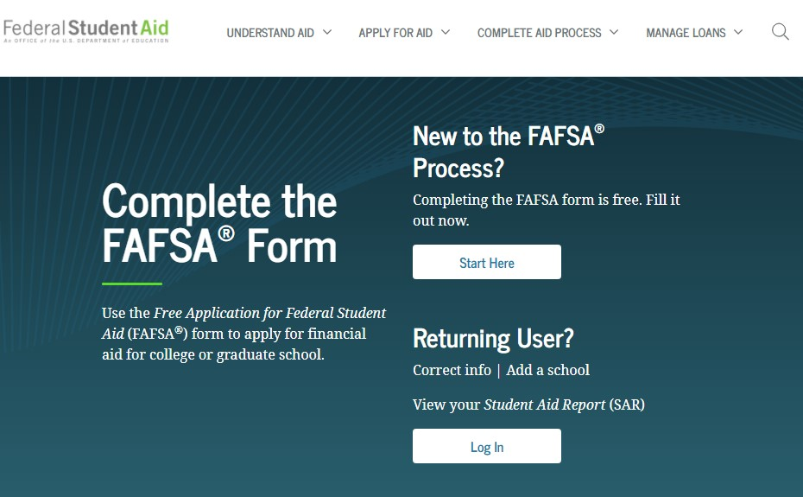
1.
What’s changing with the 2425 FAFSA?
Hopefully, it will result in more students
being Pell eligible than before!
Shorter & more user-friendly
Students can list up to 20 colleges instead of 10
Available in more languages
Applicants required to use IRS Direct Data Exchange
All “contributors” must provide financial information
SAI (Student Aid Index) is replacing EFC (Expected Family Contribution Amount)
Number in college will not be used to calculate SAI
Family farms and small businesses must be reported as assets now
https://studentaid.gov/announcements-events/fafsa-support
This Photo by Unknown Author is licensed under CC BY-SA-NC

Slide 15
1.
Other Resources:
Federal Aid
Go to https://studentaid.gov on the federal website.
Go to https://sites.highlands.edu/financial-aid/ on the highlands.edu website to view financial aid information for GHC.
State Aid
Go to www.gafutures.org and click HOPE & State Aid Programs then click different tabs to see regulations.

Slide 16
1.
Questions?
finaid@highlands.edu
OR
GHC Virtual HUB
https://sites.highlands.edu/academic-success-center/ghc-virtual-services/
OR
Call 706-802-5000 (click prompts for Office of Financial Aid)

