Slide 1
Integumentary System
A. Includes skin, hair, nails, glands; also contains sensory receptors & vascular network
B. Skin
1. Functions of the skin
A) Protection
B) Thermoregulation – via blood vessels in skin
C) Sensation
1) Tactile – touch & pressure

Slide 2
Integumentary System
2) Thermal – warmth & coolness
3) Pain
D) Excretion
1) Water and some wastes
E) Absorption
1) Fat-soluble vitamins, O₂, CO₂ and some toxins – acetone, lead, mercury and poison ivy & oak

Slide 3
Integumentary System
2. 3 distinct layers
A) Epidermis
B) Dermis
C) Hypodermis
3. Epidermis
A) Thinnest & outermost layer
B) Composed of keratinized stratified squamous epithelium (30-50 cells thick)

Slide 4
Integumentary System
C) 4 specialized cell types
1) Keratinocytes – produce keratin
2) Melanocytes – produce melanin
3) Langerhans cells – arise from bone marrow and help to activate the immune system
4) Merkel cells – associated with sensory neurons to aid in our sense of touch

Slide 5
Integumentary System
D) 4 or 5 distinct layers dependent on location
1) Stratum basale – deepest
a) 1 cell layer thick
b) Constantly reproducing
c) 10-25% melanocytes
2) Stratum spinosum
a) Several cell layers thick
b) Large number of Langerhans cells

Slide 6
Integumentary System
3) Stratum granulosum
a) 3-5 cell layers thick
b) Keratinization begins
i) Process by which cell’s internal structures die, degrade, and are replaced with keratin
c) Last layer with blood nutrient supply
4) Stratum lucidum – only in thick skin
a) Thin band of flattened cells

Slide 7
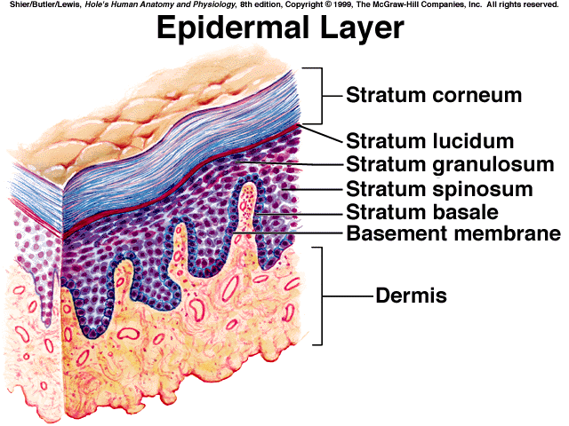
Integumentary System
5) Stratum corneum – outermost
a) 20-30 cell layers thick, 3/4 of epidermis

Slide 8
Integumentary System
4. Dermis
A) Deeper & thicker than epidermis
B) Contains vascular network that “feeds” the epidermis & sensory receptors
C) 2 layers
1) Papillary layer (20%)
a) Areolar connective tissue – flexibility

Slide 9
Integumentary System
b) Dermal papillae – extensions into the epidermis
c) Contain blood vessels, free nerve endings (pain) and Meissner’s corpuscles (touch receptors)
2) Reticular layer (80%)
a) Dense irregular connective tissue
b) Contains blood vessels, glands, hair follicles, and Pacinian corpuscles (pressure receptors)

Slide 10
Integumentary System
c) Has some flexibility but can be torn or damaged
i) Scaring/Stretch marks
ii) Blister
5. Hypodermis
A) Composed primarily of adipose tissue
B) Contains major blood vessels
6. Skin color
A) Results from a combination of 3 pigments

Slide 11
Integumentary System
1) Melanin
a) Produced by melanocytes in stratum basale
b) Red to yellow to brown-black
2) Carotene
a) Found in plants (carrots)
b) Yellow to orange
3) Hemoglobin
a) More prominent in fair-skinned people
b) Crimson

Slide 12
Integumentary System
7. Skin Disorders
A) Skin cancer – most skin tumors are benign (warts) however some can spread (cancerous)
1) Basal cell carcinoma
2) Squamous cell carcinoma
3) Melanoma
B) Dermatitis – skin inflammation

Slide 13
Integumentary System
C) Burns – damage inflicted by intense heat, electricity, radiation or certain chemicals
1) First degree
2) Second degree
3) Third degree
D) Acne – an active inflammation of the sebaceous glands

Slide 14
Integumentary System
E) Alopecia – baldness
F) Psoriasis – a chronic, non-contagious autoimmune disease which affects the skin and joints
1) Commonly causes red scaly patches to appear on the skin (psoriatic plaques)

Slide 15
Integumentary System
8. Skin derivatives
A) Hair (pili)
1) Humans are relatively hairless
a) Palms, soles, lips, nipples, penis, & labia minora are hairless
2) Serves protective function

Slide 16
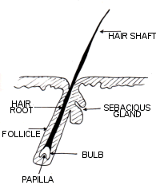
Integumentary System
3) 3 parts
a) Shaft
b) Root
c) Bulb
4) Shaft & root are subdivided into 3 layers
a) Medulla – innermost

Slide 17
Integumentary System
b) Cortex – middle
c) Cuticle
5) Root and bulb are also surrounded by a hair follicle
a) 2 layers
i) Inner root sheath
ii) Outer root sheath
b) Surrounded by a connective tissue sheath

Slide 18
Integumentary System
6) The bulb is surrounded by touch receptors
a) Primarily composed of matrix cells
i) Arise from stratum basale
ii) Responsible for the growth of existing hair
b) Contain melanocytes
c) Papilla – contains blood vessels

Slide 19
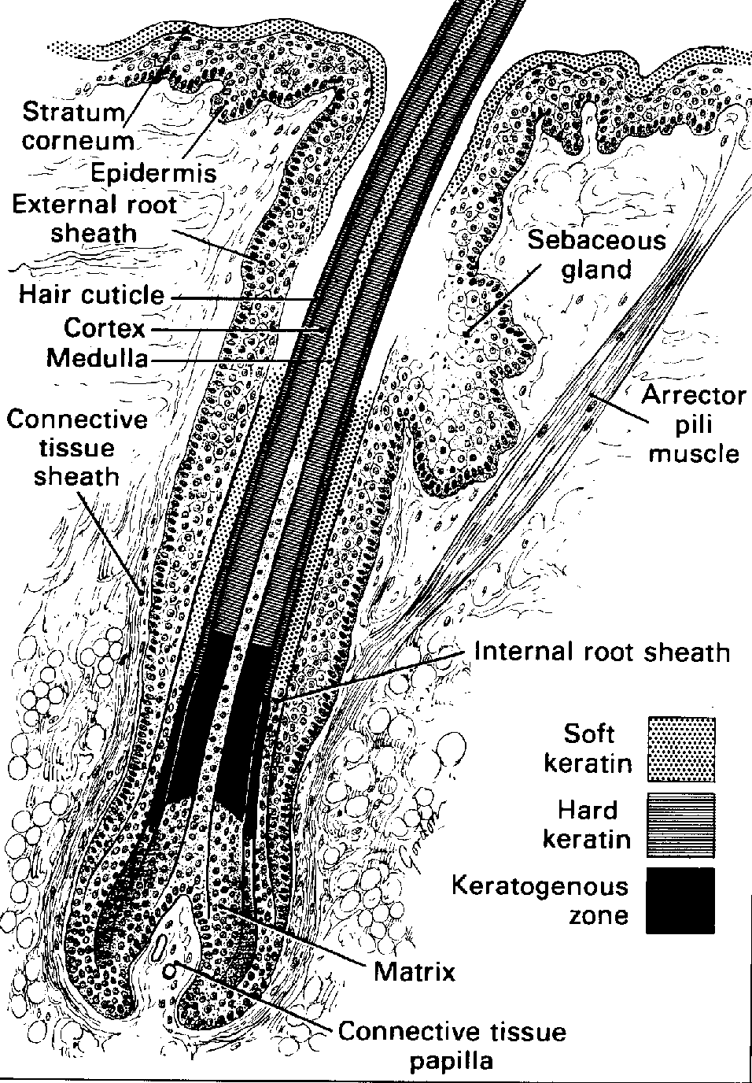
Integumentary System
7) Arrector pili muscle
a) Hair normally at an angle; cause hair to “stand up” = goose-bumps

Slide 20
Integumentary System
B) Nails
1) Protection & grasping
2) Dense parallel arrangement of keratin fibrils

Slide 21
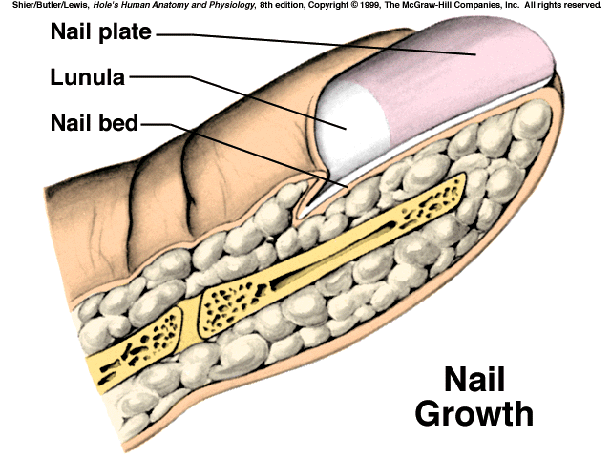
Integumentary System
3) Structures
a) Free edge – not in contact with nail bed; the part we cut
b) Body – portion on the nail bed that we can see
c) Root – also lies on nail bed but we can’t see it

Slide 22
Integumentary System
d) Nail bed – deeper epidermal layers
e) Nail matrix – thickened portion of the nail bed from which the nail grows
f) Lunula – crescent shaped, whitish portion of nail at proximal end

Slide 23
Integumentary System
g) Nail folds – folds of overlying skin on proximal and lateral sides
h) Cuticle – portion of proximal nail fold that extends onto the nail body

Slide 24
Integumentary System
C) Glands
1) Open onto epidermal layer but located in dermis
2) All exocrine
3) 4 types
a) Sebaceous glands – oil glands
i) Associated with hair follicles
ii) Produce sebum – protects hair

Slide 25
Integumentary System
b) Sudoriferous glands – sweat glands
i) Everywhere, but most numerous on palms, soles, axillary & pubic regions, and forehead
ii) 2 types
(a) Merocrine (eccrine) glands – most abundant
(i) Palms, soles & forehead
(ii) Ducts open directly onto skin
(iii) Active at birth

Slide 26
Integumentary System
(b) Apocrine glands
(i) Axillary & pubic regions
(ii) Ducts open onto hair follicles
(iii) Become active during puberty

Slide 27
Integumentary System
iii) Perspiration (Sudor)
(a) Relatively odorless
(b) Water, salts, urea, uric acid and traces of other elements
(c) Functions in cooling & excretion of wastes
(d) Contains enzymes that destroy bacteria

Slide 28
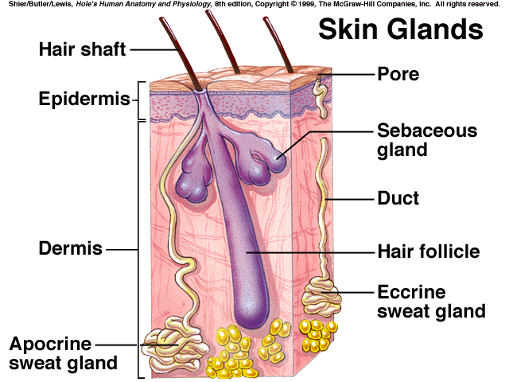

Slide 29
Integumentary System
c) Ceruminous glands
i) Found in ear canal
ii) Modified apocrine gland
iii) Cerumen – earwax
(a) Protection & keep tympanum from drying out
d) Mammary glands
i) Specialized sweat glands
ii) Produce milk for newborn

