Slide 1
Articulations
A. Joints (articulations) – wherever two bones meet
B. Functions – dependent on need for strength and mobility
1. Joints in skull are very strong & immovable
2. Joints in appendages are more flexible but not very strong (surrounding muscles provide the strength)

Slide 2
Articulations
C. There are 3 structural classifications:
1. Fibrous joints – composed of fibrous tissue with no cavity
2. Cartilaginous joints – articulating bones are united by cartilage and no cavity present
3. Synovial joints – articular bones are separated by a fluid-filled joint cavity

Slide 3
Articulations
D. There are 3 functional classifications:
1. Synarthroses – immovable joints (sternocostal, tibiofibular, sutures)
2. Amphiarthroses – slightly movable joints (intervertebral joint and pubic symphysis)
3. Diarthroses – freely movable joints (most appendicular joints)

Slide 4
Articulations
E. Fibrous Joints
1. Characteristics:
A) Bones are joined by fibrous tissue
B) No joint cavity is present
C) Most are immovable (synarthrotic) but some are slightly moveable (amphiarthrotic)
2. Three types of fibrous joints

Slide 5
Articulations
A) Sutures – contain dense fibrous connective tissue until adulthood when they ossify
1) Examples are the skull sutures
B) Syndesmoses – bones are connected by a filamentous sheet or cord (ligament or interosseous membrane)
1) Movement can range from slight to considerable
2) Examples include the tibiofibular & radioulnar (between the shafts)

Slide 6
Articulations
C) Gomphoses – articulation of tooth with alveolar margin
1) Possesses a fibrous connection called the periodontal ligament
F. Cartilaginous joints
1. Characteristics:
A) Articulating surfaces are united by cartilage
B) No joint cavity

Slide 7
Articulations
2. Two main types of cartilaginous joints:
A) Synchondroses – hyaline cartilage unites bones; usually temporary joints (sites of bone growth)
1) Cartilage is replaced by bone and the joints become synarthrotic
2) Examples are the epiphyseal plate and the first rib and the manubrium

Slide 8
Articulations
B) Symphyses – articular surface of bone covered by hyaline cartilage fused to an intervening pad or plate of fibrocartilage
1) It is compressible, resilient and functionally amphiarthrotic
2) Examples are the pubic symphysis and the intervertebral joints
G. Synovial Joints
1. Articular bones are separated by a fluid-filled joint cavity

Slide 9
Articulations
2. Most common joint in the body
3. Diarthrotic
4. Five distinct features of synovial joints
A) Articular cartilage – hyaline cartilage forms a glassy smooth surface over the opposing ends of bones
B) Synovial (joint) cavity – small space between the bones
C) Synovial fluid – largely derived from blood; has a viscous, egg-white consistency

Slide 10
Articulations
D) Articular capsule – 2 parts
1) Fibrous capsule (external)
2) Synovial membrane (internal)
E) Reinforcing ligaments
1) Intrinsic (capsular) – parallel bundles of fibers within the fibrous capsule
2) Extracapsular – extend bone to bone
3) Intracapsular – located inside the cavity

Slide 11
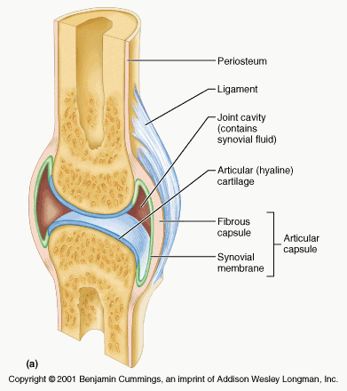

Slide 12
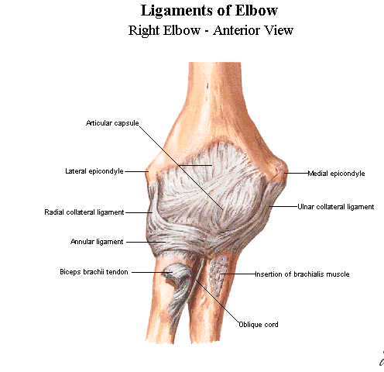
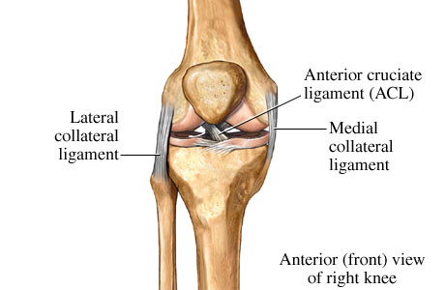

Slide 13
Articulations
5. Movement of synovial joints:
A) Axis of motion
1) Non-axial motion – slipping movements (intercarpal & intertarsal)
2) Uniaxial motion – movement in one plane (interphalangeal, ulna/humerus)

Slide 14
Articulations
3) Biaxial motion – movement in two planes (occipital bone/atlas)
4) Multiaxial motion – movement in more than two planes (scapula/humerus and coxal bone/femur)

Slide 15
Articulations
B) Types of motion
1) Gliding – bones displaced in relation to one another (intercarpal, intertarsal, and intervertebral joints)
2) Angular – changing the angle between two bones
a) Flexion – bending or decreasing the joint angle

Slide 16
Articulations
b) Extension – stretching or increasing the joint angle
c) Abduction – moving away from the midline
d) Adduction – moving towards the midline
e) Circumduction – a limb creates a conical (cone) shape in space
f) Rotation – turning movement of a bone around its own axis

Slide 17
Articulations
6. Special movements
A) Supination of the hand – turning the palm forward or facing up
B) Pronation of the hand – turning the palm backward or facing down
C) Inversion (supination) of the foot – movement of the sole inward
D) Eversion (pronation) of the foot – movement of the sole outward

Slide 18
Articulations
E) Dorsiflexion – upward movement of foot/toes
F) Plantar flexion – downward movement of foot/toes
G) Protraction – movement of the mandible forward
H) Retraction – movement of the protracted part back to its start position

Slide 19
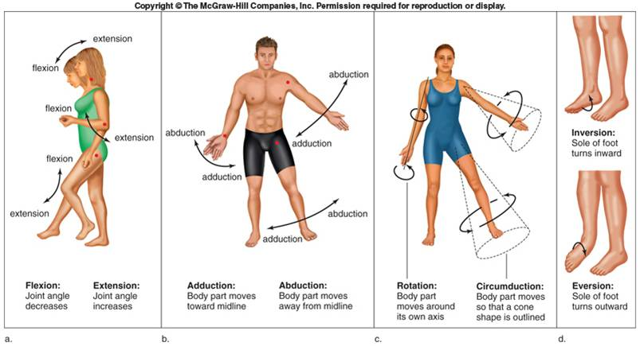

Slide 20
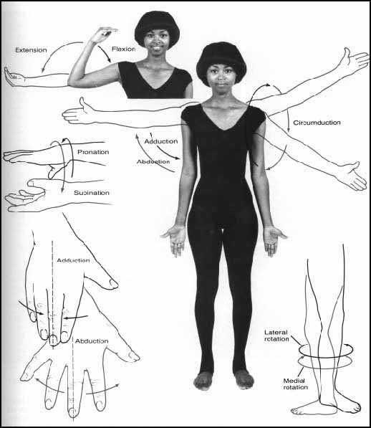

Slide 21
Articulations
I) Elevation – lifting a body part superiorly
J) Depression – moving the elevated part inferiorly
K) Opposition – touching your thumb to the tips of other fingers
7. Types of synovial joints
A) Plane joints – articular surface is flat and only allows for short gliding movements (intercarpal and intertarsal)

Slide 22
Articulations
B) Hinge joints – cylindrical projection of one bone fits into a trough-shaped surface on another bone (elbow & knee)
C) Pivot joints – rounded end of one bone protrudes into a sleeve or ring composed of bone or ligament (radius to ulna and axis to atlas)
D) Condyloid joints – oval articular surface of one bone fits into a complementary depression in another (metacarpophalanges – knuckles)

Slide 23
Articulations
E) Saddle joints – each articular surface has a concave and convex area (carpometacarpal joint of the thumb)
F) Ball and socket joints – the spherical end of one bone articulates with a cuplike socket of another bone (shoulder or hip joints)

Slide 24
Articulations
H. Common Joint Injuries
1. Sprain – stretching or tearing of a ligament
2. Luxation – bones are forced out of their normal position (a.k.a. dislocation)
A) Subluxation – partial dislocation
3. Bursitis – inflammation of the bursa
A) Bursa – flattened sacs that contain a thin film of synovial fluid; located where ligaments, muscles, and tendons rub against bone

Slide 25
Articulations
4. Tendonitis – inflammation of the tendon
5. Arthritis – inflammatory or degenerative disease of the joint where synovial membranes thicken and fluid production decreases resulting in friction and pain
A) Osteoarthritis – degenerative
B) Rheumatoid arthritis – autoimmune disease
C) Gouty arthritis – uric acid accumulation
6. Synovitis – inflammation of synovial membranes

