Slide 1
Eukaryotic Cells and Microorganisms

Slide 2
The Fungi
The Fungi
A. Once thought to be plants but the cell wall is made of chitin rather than cellulose and these are not photosynthetic
B. Instead they are saprobic organisms that frequently live off of dead organic matter

Slide 3
The Fungi
C. Mycoses
1. Fungi that grow in or on the human body and causes a disease
2. General classifications
A) Yeasts
1) Single-celled fungi

Slide 4
The Fungi
B) Molds
1) Filamentous fungi
a) Hyphae – individual filaments
i) Involved in nutrient absorption and reproduction
b) Mycelium – collection of hyphae growing on one location

Slide 5
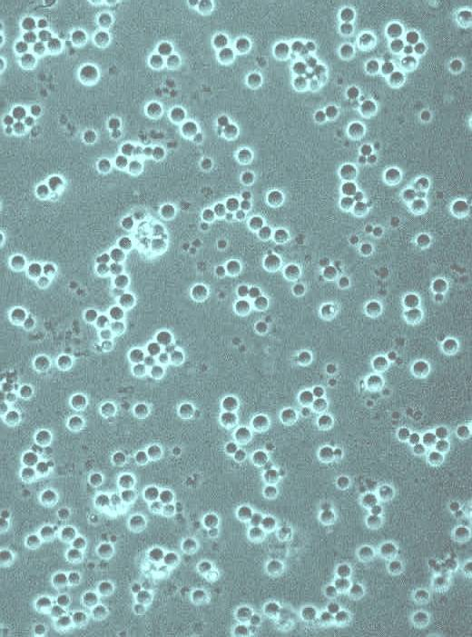
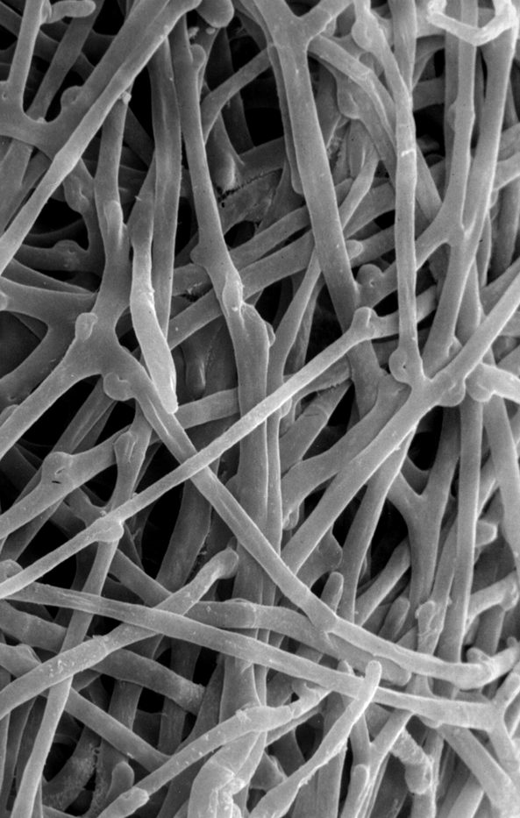

Slide 6
The Fungi
3. Specific classification is determined by the type of reproduction they exhibit
A) Zygomycetes – frequently cause food spoilage
1) Rhizopus – black bread mold
B) Basidiomycetes
1) Flibasidiella neoformans – causes a form of meningitis

Slide 7
The Fungi
C) Ascomycetes
1) Saccharomyces – used in making bread, beer and wine
2) Candida albicans – causes thrush, vaginal yeast infection and a severe skin infection in children (diaper rash)

Slide 8
The Fungi
3) Pneumocystis jiroveci – causes a lung infection that is a leading cause of death in AIDS patients
4) Coccidioides immitis – causes Valley fever
5) Histoplasma capsulatum – causes mild respiratory disease

Slide 9
The Fungi
D) Deuteromycetes (a.k.a. Fungi imperfecti)
1) Aspergillus – produces a toxin that is carcinogenic
(a) Causes Aspergillosis; an infection of the lungs
2) Penicillium – leading source of penicillin
3) The causative agents of ringworm & athlete’s foot also fall into this group

Slide 10
The Protists
The Protists
A. Sometimes not considered a true kingdom because the organisms vary tremendously from one to another. The only universal characteristic among the group is that they are all eukaryotic.
B. Classified according to whether or not the organism is more plant-like or more animal-like

Slide 11
The Protists
1. Algae
A) Plant-like organisms that possess photosynthetic pigments and a cell wall
B) These are further divided into groups on the basis of which pigments are present
1) Only two are a threat to human health
a) Gymnodinium & Gonyaulax which causes paralytic shellfish poisoning

Slide 12
The Protists
2. Protozoans
A) Animal-like organisms because the lack a cell wall and are heterotrophic
B) These are further divided on the basis of their locomotion
1) Mastigophora – motile by flagella
a) Trypanosoma brucei – causes African Sleeping Sickness

Slide 13
The Protists
b) Trichomonas vaginalis – a sexually transmitted protozoan that causes vaginitis
c) Giardia lamblia – intestinal parasite; causes Giardiasis (diarrheal illness)
2) Sarcodina – motile by pseudopodia
a) Entamoeba histolytica – causes amoebic dysentery (diarrhea)
3) Ciliophora – motile by cilia
a) Balantidium coli – causes dysentery

Slide 14
The Protists
4) Apicomplexa – usually non-motile
a) Plasmodium – causes malaria
b) Cryptosporidium – causes food-borne, diarrheal illness
c) Toxoplasma gondii – causes a form of subacute encephalitis
5) Microspora – motile via polar filament
a) Microsporidium – causes diarrhea; commonly infects persons with AIDS

Slide 15
The Helminths
The Helminths
A. Some of the groups are discussed here because of their importance in human diseases and the fact diagnosis often requires microscopic examination of eggs

Slide 16
The Helminths
1. The Parasitic Helminthes
A) Cestodes (tapeworms)
1) Taenia saginatus – beef tapeworm
2) Taenia solium – pork tapeworm
3) Dipylidium caninum – dog/cat tapeworm
4) Diphyllobothrium latum – fish tapeworm

Slide 17
The Helminths
B) Trematodes (flukes)
1) Schistosoma mansoni – blood fluke; causes schistosomiasis
2) Clonorchis sinensis – Chinese liver fluke
3) Paragonimus westermani – lung fluke
4) Fasciola buski – intestinal fluke
C) Nematodes (roundworms)
1) Enterobius vermicularis – pinworm

Slide 18
The Helminths
2) Necator americanus – hookworm
3) Wucheria bancrofti – elephantiasis
4) Trichinella spiralis – trichinosis
5) Trichuris trichiura – whipworm
6) Loa loa – loaiasis
7) Ascaris lumbricoides – ascariasis
8) Onchocerca volvulus – river blindness

Slide 19
The Arthropods
The Arthropods
A. Insects – serve as biological vectors
1. Mosquitoes
A) Plasmodium – Malaria
B) Flavivirus – Yellow fever
C) West Nile virus (WNV) – West Nile fever
2. Fleas
A) Yersinia pestis – Plague
B) Rickettsia typhi – Endemic typhus

Slide 20
The Arthropods
3. Lice
A) Rickettsia prowazekii – Epidemic typhus
B) Bartonella quintana – Trench fever
4. Ticks
A) Rickettsia rickettsii – Rocky Mountain Spotted Fever
B) Borrelia burgdorferi – Lyme disease
C) Francisella tularensis – Rabbit fever

Slide 21
The Arthropods
5. Flies (biting)
A) Loa loa – loaisis
B) Trypanosoma – African Sleeping Sickness
C) Onchocerca volvulus – River blindness

