Slide 1
Blood
1. Functions
A) Transportation of nutrients & waste
B) Regulation of pH & body temperature
C) Protection from blood loss & foreign invasion
2. Characteristics
A) Liquid connective tissue
B) 8% of human body weight

Slide 2
Blood
C) 4-5 times more viscous than water
D) NaCl conc. of 0.85-0.9%
E) pH ranges from 7.35-7.45
F) Total blood volume varies
1) 5-6L for males
2) 4-5L for females

Slide 3
Blood
G) Components
1) Plasma (55%)
a) About 90-92% water
b) Contains nutrients & wastes
c) Contains plasma proteins
d) Serum

Slide 4
Blood
2) Formed elements (45%)
a) Erythrocytes (RBC)
b) Leukocytes (WBC)
c) Platelets (thrombocytes)

Slide 5
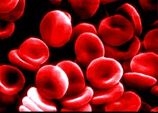
Blood
3. Red Blood Cells (erythrocytes)
A) Biconcave shape – provides:
1) Greater surface area
2) Flexibility
B) Anucleate
C) Contain hemoglobin
(~280 million molecules/RBC)

Slide 6
Blood
1) Globin – structural protein composed of 4 polypeptide chains each containing a heme group
2) Heme group – iron-containing functional portion of the hemoglobin
a) Fe⁺⁺ – forms a reversible bond with O₂

Slide 7
Blood
D) Normal RBC counts: (1 drop ~50mm³)
Males = 4.7–6.1 mil/mm³
Females = 4.2–5.4 mil/mm³
Children = 4.6 – 4.8 mil/mm³
E) New cells produced at rate of ~2 mil/sec, live ~120 days
1) Controlled by erythropoietin

Slide 8
Blood
F) Erythrocytic Disorders
1) Anemia
a) Aplastic anemia – faulty bone marrow
i) Often caused by radiation, drug use, bacterial toxins, some poisons, and some antibiotics
b) Pernicious anemia – decreased B₁₂ (necessary for RBC production)
c) Hemolytic anemia

Slide 9
Blood
d) Hemorrhagic anemia
e) Iron-deficiency anemia
i) Results in microcytes
f) Sickle-cell anemia
i) Genetic defect causes one globin chain to become rigid

Slide 10
Blood
g) Thalassemia
i) Genetic defect resulting in absent or faulty globin chain
2) Polycythemia
a) Primary polycythemia (polycythemia vera)
b) Secondary polycythemia
FYI: Blood-doping

Slide 11
Blood
G) Erythropoiesis – controlled by erythropoietin
1) Hemocytoblast
2) Proerythroblast
3) Erythroblast

Slide 12
Blood
4) Normoblast
5) Reticulocyte – enter circulation and carry O₂; continue to lose organelles
6) Erythrocyte (RBC)

Slide 13
Blood
4. White Blood Cells (leukocytes)
A) ~5,000 - 10,000/mm³; most live only a few days, but their lifespan ranges from a few minutes to years
B) There are 5 types of WBC broken down into 2 categories
1) Granulocytes (granular WBC)

Slide 14
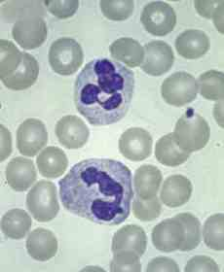
Blood
a) Neutrophils (polymorphonuclear leukocytes) (50-70%)
i) Numerous fine granules which stain pale lilac w/ a darker multi-lobed nucleus
ii) Phagocytes

Slide 15
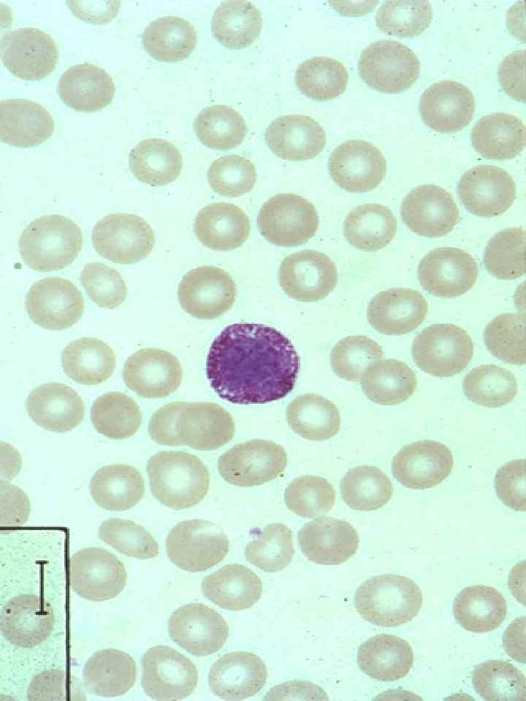
Blood
b) Basophils (0.5-1%)
i) Purplish-black granules that often obscure a bilobed nucleus
ii) Intensify inflammation and allergic reactions

Slide 16
Blood
iii) Chemicals released include histamine, heparin, leukotrienes, and prostaglandins
iv) Were once thought to develop into mast cells
(a) Have identical functions except mast cells are only found outside the bloodstream

Slide 17
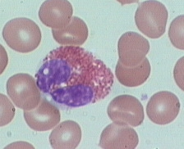
Blood
c) Eosinophils (2-4%)
i) Distinct red granules; bilobed nucleus
ii) Phagocytes, combat parasitic worms & release anti-inflammatory chemicals

Slide 18
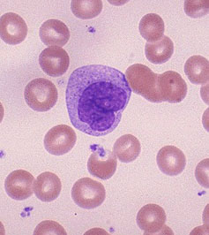
Blood
2) Agranulocytes
a) Monocytes (3-8%)
i) Pale-blue cytoplasm w/ U or kidney shaped nucleus
ii) Develop into macrophages once in tissue
iii) Phagocytes

Slide 19
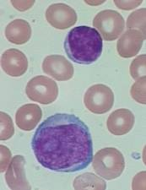
Blood
b) Lymphocytes (20-25%)
i) Large, dark-purple nucleus occupies most of the cell
ii) Produce antibodies and provide immunity

Slide 20
Blood
iii) 3 types
(a) B lymphocytes
(i) Attack bacteria & their toxins
(ii) Develop into plasma cells which release antibodies

Slide 21
Blood
(b) T lymphocytes
(i) Attack viruses, fungi, cancer cells, transplanted cells & some bacteria
(ii) Work w/ B cells to provide immunity

Slide 22
Blood
(c) Natural Killer (NK) cells
(i) Kill cells that have been bound by antibodies or cells that exhibit abnormal traits
(ii) Use perforins & granzymes to destroy the cells

Slide 23
Blood
C) Leukocytic Disorders
1) Leukopenia – decreased WBC count
a) Often caused by gluccocorticoids and various cancer & HIV drugs
2) Leukocytosis – increased WBC count
a) Often caused by acute infections, inflammation, or hemorrhage
3) Infectious mononucleosis (mono)
a) Caused by Epstein-Barr virus

Slide 24
Blood
4) Leukemia
a) Group of cancerous conditions involving WBC
b) May be named for cells affected
i) Ex. myelocytic leukemia or lymphocytic leukemia
c) May be named for the WBC’s stage
i) Ex. acute leukemia or chronic leukemia

Slide 25
Blood
D) Leukopoiesis
1) Stimulated by interlukins (IL) & colony-stimulating factors (CSF)
2) Multiple pathways but all start w/ hemocytoblasts in red bone marrow
a) Monoblast
i) Promonocyte
ii) Monocyte

Slide 26
Blood
b) Lymphoblast
i) Prolymphocyte
ii) Lymphocyte
c) Myeloblast
i) Promyelocyte
ii) Myelocyte
(a) Eosinophilic, basophilic or neutrophilic

Slide 27
Blood
iii) Band cell
(a) Eosinophilic, basophilic or neutrophilic
iv) Eosinophil, basophil or neutrophil
5. Platelets
A) ~250,000 - 400,000/mm³, live 5-9 days
B) Stop blood loss – 3 mechanisms

Slide 28
Blood
1) Vascular spasm
a) Vasoconstriction of damaged vessel
b) Can last minutes – hours
2) Platelet plug formation
a) Triggered by von Willebrand factor (VWF)
i) Adhere to exposed collagen fibers
ii) Activates platelets

Slide 29
Blood
b) Platelet adhesion
i) Initial sticking of platelets to the wound site
ii) Activates more platelets
c) Platelet aggregation
i) The sticking of platelets to already present platelets

Slide 30
Blood
d) Platelet plug
i) A cluster of platelets that temporarily seals the break in a vessel wall
3) Coagulation (blood clotting)
a) Involves over 30 different chemicals including:
i) 13 different clotting factors

Slide 31
Blood
ii) Vitamin K
iii) Ca⁺⁺
b) Prothrombin activator (enzyme) is formed following the coming together of various clotting factors
c) Prothrombin activator converts prothrombin (plasma protein) to thrombin (enzyme)

Slide 32
Blood
d) Thrombin converts fibrinogen (plasma protein) to fibrin (fibers of the clot)
e) Formed elements become trapped in fibrin
f) Serum filters out
i) Clot results
g) Clot retraction
h) Fibrinolysis

Slide 33
Blood
C) Clotting Disorders
1) Thrombus – a clot in a healthy vessel
2) Embolus – a thrombus that has broken free and entered circulation
3) Embolism – when an embolus becomes trapped in another vessel; can lead to death if it occurs in the heart or lungs

Slide 34
Blood
4) Hemophilia – an inability of the blood to clot properly
a) Sex-linked disorder
5) Thrombocytopenia
a) Decreased platelet count
b) Caused by any condition that suppresses or destroys bone marrow

Slide 35
Blood
D) Thrombopoiesis
1) Stimulated by thrombopoietin
a) Hemocytoblast
b) Megakaryoblast
c) Promegakaryocyte
d) Megakaryocyte
i) Ruptures as it enters circulation
e) Platelet

Slide 36
Blood
6. Blood Typing
A) Based on presence/absence of specific antigens
B) ABO Groups
1) Determined by the presence or absence of antigens A & B
a) Type A blood – has only antigen A
b) Type B blood – has only antigen B

Slide 37
Blood
c) Type AB blood – has antigens A & B
d) Type O blood – has neither antigen
2) Blood also contain antibodies against the antigen(s) the RBC don’t have
a) Type A blood – has B antibodies
b) Type B blood – has A antibodies
c) Type AB blood – has no antibodies
d) Type O blood – has A & B antibodies

Slide 38
Blood
D) Rh Group
1) Refers to the presence or absence of Rh antigens (there are at least 45 different ones)
a) Rh+ has at least one Rh antigen
b) Rh- has no Rh antigens
2) Antibodies are not present against Rh antigen(s) unless conflicting blood has been introduced

Slide 39
Blood
a) First exposure – no immune response (rejection)
b) Subsequent exposures will result in an immune response (rejection)
E) Transfusions
1) If the body sees a foreign antigen it will attack the RBC causing them to clump together
2) Always try to match blood types

Slide 40
Blood
3) Some exceptions can be made
a) Type O is the universal donor
b) Type AB is the universal recipient
4) Complications
a) Clumping in small vessels
b) RBC are destroyed by immune system releasing hemoglobin
c) Flu-like symptoms are common

Slide 41
Blood
Blood Type | Antigens Present | Antibodies Present | Can Receive Blood From: | Can Donate Blood To:
A | A | B | A & O | A & AB
B | B | A | B & O | B & AB
AB | A & B | none | A, B, AB & O | AB only
O | none | A & B | O only | A, B, AB & O

Slide 42
Blood
5) Hemolytic Disease of the Newborn
a) Also called Erythroblastosis fetalis
b) Results when mother is Rh⁻ and baby is Rh⁺
c) Upon delivery, Rh⁺ antigens from the baby are transferred to the mother’s bloodstream which causes her to produce anti-Rh antibodies

Slide 43
Blood
d) If the mother becomes pregnant again with an Rh⁺ child, the antibodies cross the placenta, enter the circulation of the fetus, and cause extensive fetal erythrocyte damage
e) Can be prevented in most all cases with the use of RhoGam

