Slide 1
Chapter 16
Disorders in Immunity

Slide 2
Immunological Disorders
Introduction
A. There are three types of immunological disorders
1. Hypersensitivity
2. Autoimmune disease
3. Immunodeficiency
B. Hypersensitivity reactions to usually harmless substances are often called allergies or allergic reactions

Slide 3
Immunological Disorders
1. Allergens – antigens that cause allergic reactions
C. Most allergic reactions fall into one of four major types:
1. Type I: Immediate IgE-mediated
2. Type II: Cytotoxic
3. Type III: Immune complex-mediated
4. Type IV: Delayed cell-mediated

Slide 4
Immunological Disorders
Type I Hypersensitivity
A. Also called IgE Mediated Hypersensitivity
B. Mechanism
1. First exposure to antigen induces an IgE antibody response leading to sensitization
A) Antigen is taken up by dendritic cells (APC) and merged with MHC molecules

Slide 5
Immunological Disorders
B) APC presents the antigen to T-cells
C) Activated T-cells release cytokines that stimulate B-cells to produce plasma cells which secrete large amounts of IgE
D) IgE antibodies bind to mast cell/basophil receptors and the individual is now “sensitized”

Slide 6
Immunological Disorders
2. During the subsequent exposures, antigens activate IgE antibodies on the mast cell/basophil causing it to degranulate
A) Histamines, leukotrienes, prostaglandins, and/or cytokines are released
B) These chemicals are the cause of hives, hay fever, asthma and anaphylactic shock
3. Reactions generally occur within 30 minutes of exposure

Slide 7
Immunological Disorders
C. Localized Anaphylaxis
1. Hives – an allergic skin condition characterized by the formation of a wheal and flare pattern
A) Frequently the result of seafood allergies
B) These reactions are due to the release of histamine which causes dilation of tiny blood vessels and the leaking of plasma into the area

Slide 8
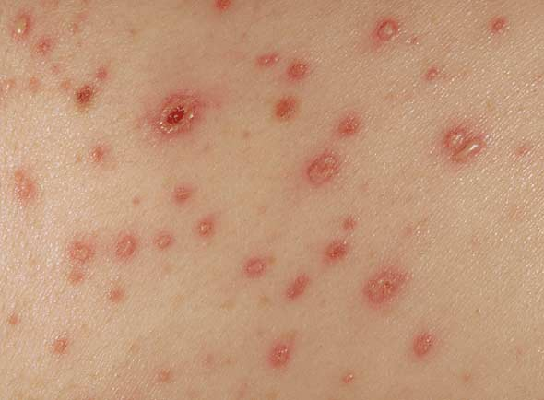

Slide 9
Immunological Disorders
2. Hay fever – itchy, teary eyes, sneezing, and runny nose; occurs when allergic person inhales an antigen rather than ingests it
A) Also mediated by histamine
3. Asthma – inhaled allergen causes chemical mediators from IgE to stimulate increased mucus secretions and spasms of the bronchi
A) Leukotrienes and prostaglandins are responsible

Slide 10
Immunological Disorders
D. Generalized Anaphylaxis
1. Antigen enters the bloodstream and becomes widespread and the reaction affects almost the entire body (systemic)
2. Loss of fluid from the blood vessels into tissues causes swelling and possibly shock
3. Reactions may be fatal within minutes
4. Bee sting, peanut, and penicillin allergies account for most cases

Slide 11
Immunological Disorders
5. Can usually be controlled by epinephrine injections
E. Immunotherapy
1. Desensitization or immunotherapy is often effective in decreasing the Type I hypersensitivity state

Slide 12
Immunological Disorders
A) Repeated injections of very small amounts of antigen are given over several months
B) This regimen leads to the formation of specific IgG antibodies
C) The IgG reacts with antigen before it can bind to IgE and therefore it blocks the IgE reaction that might result in allergic reactions

Slide 13
Immunological Disorders
Type II Hypersensitivity
A. Also called Cytotoxic Hypersensitivity because it utilizes antibodies that can destroy normal cells by complement lysis or by antibody-dependent cellular cytotoxicity (ADCC)
B. Generally occur within hours after exposure
C. Transfusion Reactions – the ABO blood groups are the major cause of hemolytic anemia in blood transfusion patients

Slide 14
Immunological Disorders
1. Recall that persons with A type blood possess the A antigen and the natural antibody anti-B
2. Persons with B type blood possess the B antigen and the natural antibody anti-A
3. Persons with O type blood lack both the A and B antigens but possess both the natural antibodies anti-A and anti-B

Slide 15
Immunological Disorders
4. Persons with AB type blood possess both the A and B antigens but posses no natural antibodies
5. In the case of ABO incompatibility, the antibodies cause reactions that include fever, low blood pressure, pain, nausea, and vomiting
6. Cross-matching the bloods and other techniques are used to ensure compatibility of donor and recipient

Slide 16
Immunological Disorders
D. Hemolytic Disease of the Newborn
1. Also called Erythroblastosis fetalis
2. Results when mother is Rh⁻ and baby is Rh⁺
3. Upon delivery, Rh⁺ antigens are transferred to the mother’s bloodstream which causes her to produce anti-Rh antibodies

Slide 17
Immunological Disorders
4. If the mother becomes pregnant again with an Rh⁺ child, the antibodies cross the placenta, enter the circulation of the fetus, and cause extensive fetal erythrocyte damage
5. RhoGAM may be administered to prevent this reaction
A) Contains Rh antibodies and prevents the mother’s natural production of them
B) Widely used at 28 weeks and after delivery during all susceptible pregnancies

Slide 18
Immunological Disorders
Type III Hypersensitivity
A. Also called Immune Complex-Mediated Hypersensitivity
B. Occurs within hours or days after exposure
C. When there is a slight excess of antigen, the antigen-antibody complexes activate complements and stimulate neutrophil and basophil degranulation

Slide 19
Immunological Disorders
1. Results in vasodilation, increased vascular permeability, and inflammation
D. Small antigen-antibody complexes are often deposited in the walls of small blood vessels in skin, joints and kidneys where they continue to cause inflammation and eventually tissue damage

Slide 20
Immunological Disorders
E. The complexes can also precipitate causing clots to form in the small blood vessels leading to failure or death of the organ
1. Known as disseminated intravascular coagulation
F. Examples of Type III Hypersensitivity are:
1. Arthus reaction – localized tissue death
A) Ex. Chronic Obstructive Pulmonary Disease (COPD)
2. Serum sickness – seen in individuals immunized/treated with animal serum

Slide 21
Immunological Disorders
Type IV Hypersensitivity
A. Also called Delayed Cell-Mediated Hypersensitivity
1. Occurs within days after exposure
B. T-cells rather than antibodies are involved with this type
C. Examples of delayed hypersensitivity are:

Slide 22
Immunological Disorders
1. Tuberculin skin test – a positive test results when circulating T-cells (which are only present if the person has been exposed) bind to the protein antigens of the tuberculosis bacteria introduced under the skin
A) Peaks 2-3 days after exposure

Slide 23
Immunological Disorders
B) The redness results mainly from sensitized T-cell reactions, the release of cytokines and the influx of macrophages to the injection site
C) False positive tests can result from exposure to another species of Mycobacterium or use of the BCG vaccine

Slide 24
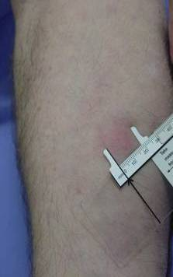
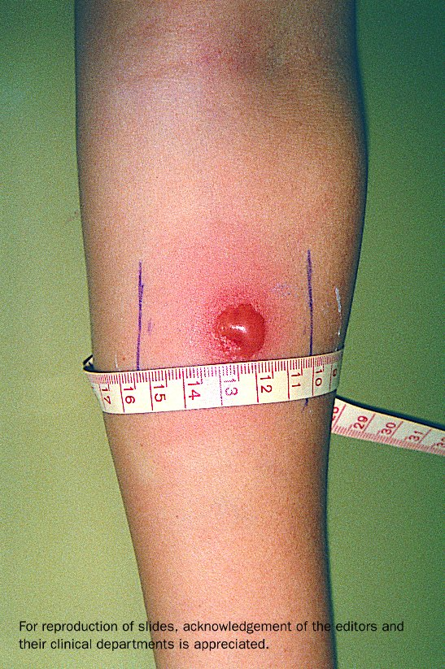

Slide 25
Immunological Disorders
2. Contact hypersensitivity – mediated by T-cells that release cytokines when they come into contact with the same antigen
A) The cytokines cause inflammation which attracts WBC to the site
B) These then release chemicals that result in allergic dermatitis or contact dermatitis
C) Examples: poison ivy, poison oak, nickel reactions, and latex reactions

Slide 26
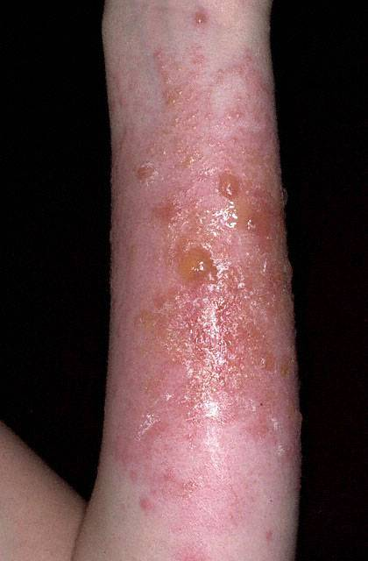
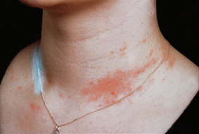

Slide 27
Immunological Disorders
3. Delayed hypersensitivity to infectious diseases – as T-cells destroy macrophages and sick body cells, tissue damage results
A) Examples: leprosy, tuberculosis, and herpes simplex infections

Slide 28
Immunological Disorders
Transplant Immunity
A. 4 types of transplants
1. Autografts – grafts from the same person
2. Isografts – grafts donated by a genetically identical twin
3. Allografts – grafts between non-identical humans
4. Xenografts – transplantation of tissue from a non-human organism

Slide 29
Immunological Disorders
B. Transplantation rejection of allografts and xenografts are caused largely by Type IV cellular reaction
C. Transplant success is dictated by the similarity of the MHC antigens on the surface of human cells

Slide 30
Immunological Disorders
1. MHC tissue typing is done in an effort to ensure that no major tissue incompatibilities exist between patient and donor
D. Often immunosuppressive drugs are taken to reduce rejection
1. These drug treatments however, make the patient susceptible to opportunistic infections

Slide 31
Immunological Disorders
Autoimmune Diseases
A. Autoimmune diseases occur when the immune system of the body responds to its own tissues as if they were foreign
B. May result from normal reactions to antigens that are similar, though not identical, to the host’s normal antigens

Slide 32
Immunological Disorders
C. Autoimmune reactions occur over a spectrum ranging from organ-specific to widespread response not limited to any one tissue
1. Grave’s disease (thyroid) and Type-1 diabetes (pancreas) are organ specific
2. Lupus and rheumatoid arthritis are considered widespread

Slide 33
Immunological Disorders
D. Treatment of Autoimmune diseases
1. Usually treated with immunosuppressive drugs that kill dividing T-cells and thus control the response
2. Also treated with drugs that interfere with T-cell signaling such as cyclosporin
3. Steroids and other anti-inflammatory drugs are often used to relieve symptoms

Slide 34
Immunological Disorders
4. Some patients require replacement therapy (ex. insulin for diabetics)
5. Transplantation of damaged organ is a last resort

