Slide 1
Male Reproductive System
A. Functions
1. Spermatogenesis – production of reproductive cells (sperm)
2. Copulation – transfer of sperm to female
3. Production of hormones
B. Structures
1. Scrotum
A) Protective sac around testes

Slide 2
Male Reproductive System
B) Regulate temperature (92ºF/33ºC)
2. Testes
A) Site of spermatogenesis & hormone production
B) Structures
1) Tunica albuginea – outer cell layer
2) Each testis is subdivided into lobules

Slide 3
Male Reproductive System
3) Each lobule contains 1-4 highly convoluted seminiferous tubules
a) The tubules contain the spermatogonia, which will mature into sperm
b) In between the tubules are interstitial cells, which produce hormones
i) Testosterone & inhibin
4) The tubules converge and unite to form the rete testis
5) The rete testis gives rise to several ducts, which open into the epididymis

Slide 4
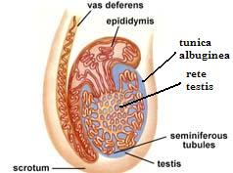
Male Reproductive System
3. Epididymis
A) Site of sperm maturation and storage
B) Takes 20 days for sperm to travel through it
C) Can store sperm for several months

Slide 5
Male Reproductive System
4. Vas deferens
A) Conduct and store sperm
B) Move upward in spermatic cord into pelvic cavity
C) Both sides join with ducts of the seminal vesicles to form the ejaculatory duct which flows into urethra
5. Prostate gland
A) Chestnut shaped

Slide 6
Male Reproductive System
B) Encircles urethra inferior to the bladder
C) Expels thin, milky fluid through a series of ducts
1) Comprises about 33% of semen
2) Slightly alkaline, serves 2 purposes
a) Neutralizes acidic fluid created by the sperm’s metabolism
b) Neutralizes acidic vaginal secretions which would kill the sperm

Slide 7
Male Reproductive System
6. Seminal vesicles
A) Yellowish, finger-shaped structures
B) Slightly inferior and posterior to bladder
C) Produces a component of semen (60%)
1) Slightly alkaline
2) Contains fructose to fuel the sperm
3) Also contains prostaglandins to initiate smooth muscle contractions in female reproductive tract

Slide 8
Male Reproductive System
7. Bulbourethral glands
A) Pea-sized; empty into the spongy urethra
B) Secrete clear, mucus fluid (smallest component of semen)
1) Alkaline to neutralize acidic urine in urethra
2) Provides some lubrication for intercourse
8. Penis
A) Composed of 3 columns of erectile tissue

Slide 9
Male Reproductive System
1) Corpora cavernosa (2) – lie dorsally
2) Corpus spongiosum – lie ventrally; surrounds urethra
B) Terminates in enlarged portion known as glans penis (covered by prepuce)
1) Location of external urethral orifice
2) Highly innervated with sensory neurons
3) Involved w/ physiological, sexual arousal

Slide 10
Male Reproductive System
9. Urethra
A) Transports semen and urine to the outside of the body
B) 3 divisions
1) Prostatic – passes through prostate
2) Membranous – passes through urogenital diaphragm
3) Spongy – passes through penis

Slide 11
Male Reproductive System
C. Spermatogenesis
1. The seminiferous tubules consist of 2 types of cells
A) Spermatogonia (spermatogenic cells)
1) Give rise to sperm
2) Diploid (46 chromosomes) and undifferentiated
B) Sertoli cells
1) Support, nourish, and regulate spermatogonia

Slide 12
Male Reproductive System
2. Process – starts during embryonic development
A) During development hormones activate a spermatogonium, which undergoes mitosis
B) One of the daughter cells (Type A) remains undifferentiated and replaces the parent, the other (Type B) enlarges to become a primary spermatocyte (diploid)
1) The process halts here until puberty

Slide 13
Male Reproductive System
C) At puberty, hormones restart the division (mitosis) of the spermatogonia
D) The primary spermatocyte undergoes meiosis I resulting in 2 secondary spermatocytes which are haploid (23 chromosomes)
E) The 2 secondary spermatocytes undergo meiosis II, resulting in 4 haploid spermatids (2 from each secondary spermatocytes)

Slide 14
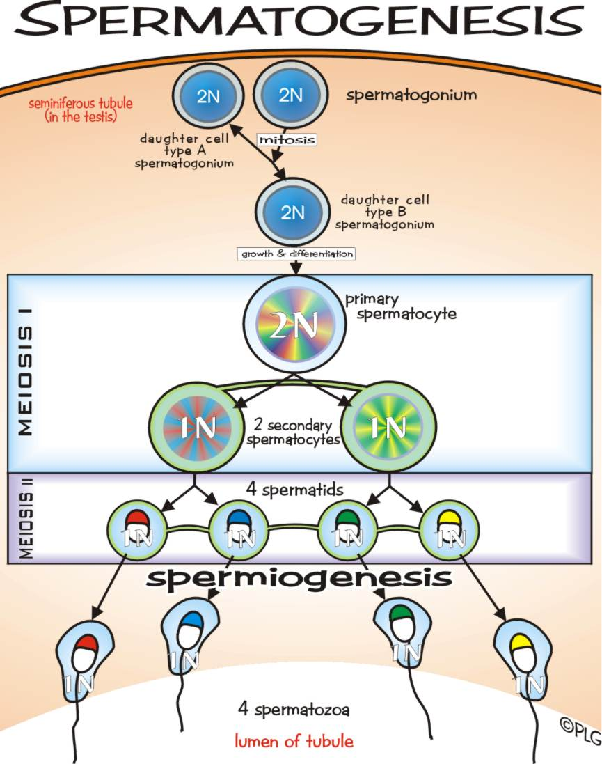

Slide 15
Male Reproductive System
F) The spermatids will then mature into sperm cells (spermatozoa)
1) The sperm cells collect in the seminiferous tubules, then pass through the rete testis into the epididymis where they accumulate and mature
3. Sperm Structure
A) Tiny tadpole-shaped cell

Slide 16
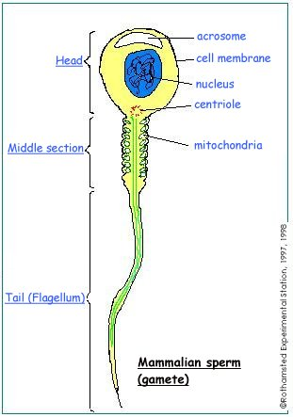
Male Reproductive System
B) About 0.06 mm long
C) Has 3 components
1) Head
a) Contains a compact nucleus with the genetic material

Slide 17
Male Reproductive System
b) Acrosome
i) Small protrusion at the anterior end
ii) Contains enzymes that help it penetrate the egg’s membrane
2) Body (Midpiece)
a) Contains protein filaments and mitochondria

Slide 18
Male Reproductive System
3) Tail (Flagella)
a) Allows the sperm to move
b) Gets ATP from mitochondria in the body

Slide 19
Male Reproductive System
D. Erection, Orgasm, & Ejaculation
1. Erection
A) Hardening of a normally flaccid penis allowing its entry into the vagina
B) Results from a filling of the erectile tissue (corpus spongiosum & corpora cavernosa) with blood
1) Triggered by tactile and/or psychological stimuli resulting in a parasympathetic reflex

Slide 20
Male Reproductive System
a) Causes a release of nitric oxide from local cells
2) Causes vasodilation of arteries leading to penis
a) No change in the veins leaving the penis
b) As extra blood fills the penis, the veins compress reducing blood flow leaving the penis
3) Extra blood fills the erectile tissue causing it to expand

Slide 21
Male Reproductive System
4) Parasympathetic input also causes the bulbourethral glands to release their secretions (pre-ejaculate)
2. Orgasm (a.k.a. climax)
A) Pleasurable feeling of physiological & psychological release
B) Results due to continuation of same stimuli that causes erection

Slide 22
Male Reproductive System
C) Usually accompanies ejaculation
D) Physiological changes include:
1) Increased heart rate (up to 180 bpm), respiration, & BP
2) Heightened emotions
3) Generalized skeletal muscle contraction
E) Followed by a latent period that prevents male from having second orgasm for minutes to hours

Slide 23
Male Reproductive System
3. Ejaculation
A) The forceful expulsion of semen into the urethra and out of the penis
B) Results from a sympathetic reflex triggered by same stimuli that trigger erection & orgasm
1) Sympathetic impulses cause contraction of smooth muscle lining of the accessory glands and ducts forcing secretions into the urethra (emission)

Slide 24
Male Reproductive System
2) Emission triggers skeletal muscle contractions at the base of the penis forcing semen out of the urethra at a high rate of speed (200 inches/sec)
3) Also causes constriction of internal urethral sphincter to prevent urine from escaping the bladder
C) Sympathetic impulses over-ride parasympathetic ones causing the penis to return to its flaccid state

Slide 25
Male Reproductive System
4. Characteristics of semen
A) pH – 7.2 to 7.6
B) Normal discharge – 2-6ml per ejaculation
1) Average = 2.75ml
C) Sperm count is roughly 50 to 130 million/ml
1) Average = 66 million/ml (180 million total)

Slide 26
Male Reproductive System
D) Morphology – <35% are abnormal
E) Motility – 60% exhibit forward motility
F) Survival – can live 24-72 hours after ejaculation into the female
1) Can be stored for 18 hours to 10 days in the male reproductive tract before losing their ability to fertilize an egg

Slide 27
Male Reproductive System
E. Hormones
1. Testes (interstitial cells)
A) Release testosterone & inhibin
1) Causes secondary sex characteristics
a) Increased hair growth on most of body
i) May slow hair growth on scalp
b) Enlargement of larynx and vocal folds
i) Results in a deeper voice

Slide 28
Male Reproductive System
c) Thickening of the skin
d) Increased muscular development
e) Broadening of the shoulders
f) Narrowing of the waist
g) Thickening and strengthening of the bones
h) Increased release of erythropoietin → increases RBC count
2) Inhibits release of LH

Slide 29
Male Reproductive System
F. Disorders
1. Testicular cancer (1 in every 20,000 males) – most common cancer in men ages 15 to 35
2. Prostatomegaly – enlargement of the prostate
A) Leads to anuria or inability to achieve an erection
3. Prostatitis – inflammation of the prostate
4. Orchitis – inflammation of the testis
5. Epididymitis – inflammation of the epididymis

Slide 30
Male Reproductive System
6. Impotence – inability to achieve an erection
A) Usually caused by reduced nitric oxide levels or hardening of the arterioles leading to the penis
1) Nitric oxide release decreases with age
a) Drugs such as Viagra, Levitra, and Cialis work by increasing nitric oxide levels
2) Can also be reduced by stress, alcohol, and drugs

Slide 31
Male Reproductive System
3) Smoking causes hardening of the arterioles
a) #1 cause in men under 40
B) 50% of men over 40 and 70% of men over 70 experience it to varying degrees
7. Priapism – prolonged and painful erection that can last for hours to days
A) Treatment ranges from simple medications to surgery depending on severity

Slide 32
Male Reproductive System
8. Cryptorchidism – failure of testes to descend into the scrotum
A) #1 precursor for testicular cancer
9. Sexually transmitted diseases – variety of disorders usually caused by a bacteria or virus
A) Can often lead to reproductive difficulty or dysfunction in males and females

Slide 33
Male Reproductive System
B) Examples include gonorrhea, syphilis, chlamydia, genital warts, genital herpes
9. Sterility – low sperm counts (<20 million/ml)

