Slide 1
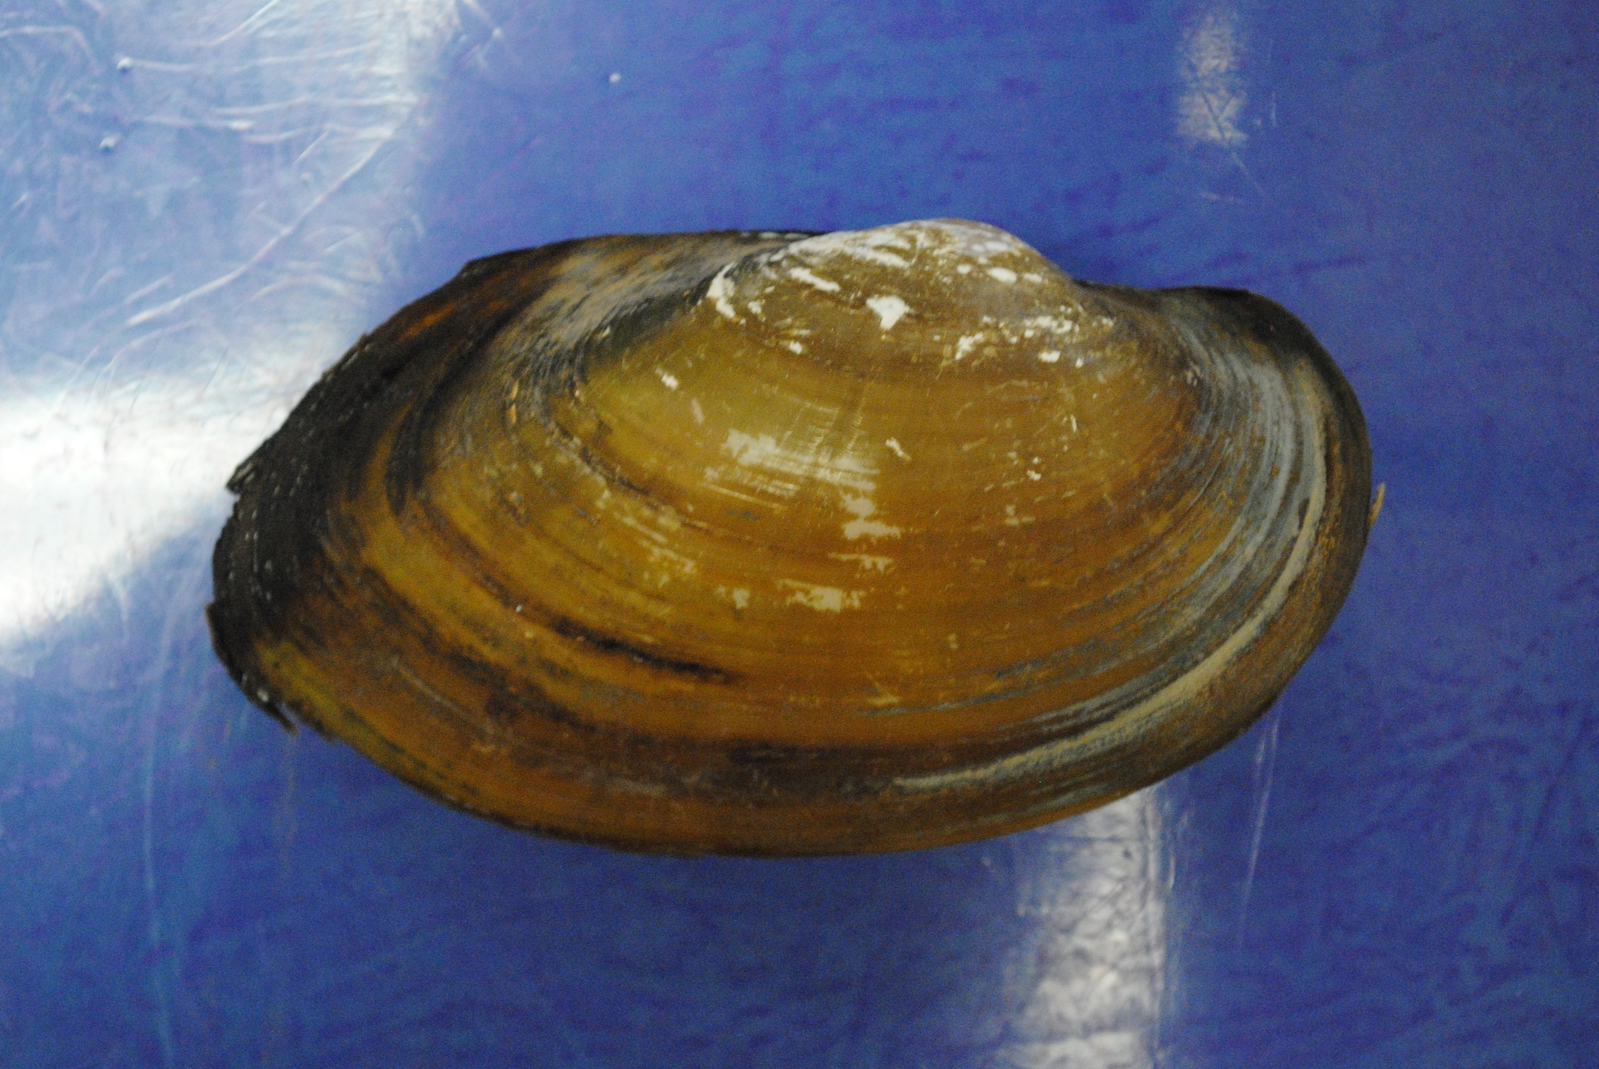
Umbo (beak)
Growth ring on exoskeleton

Slide 2
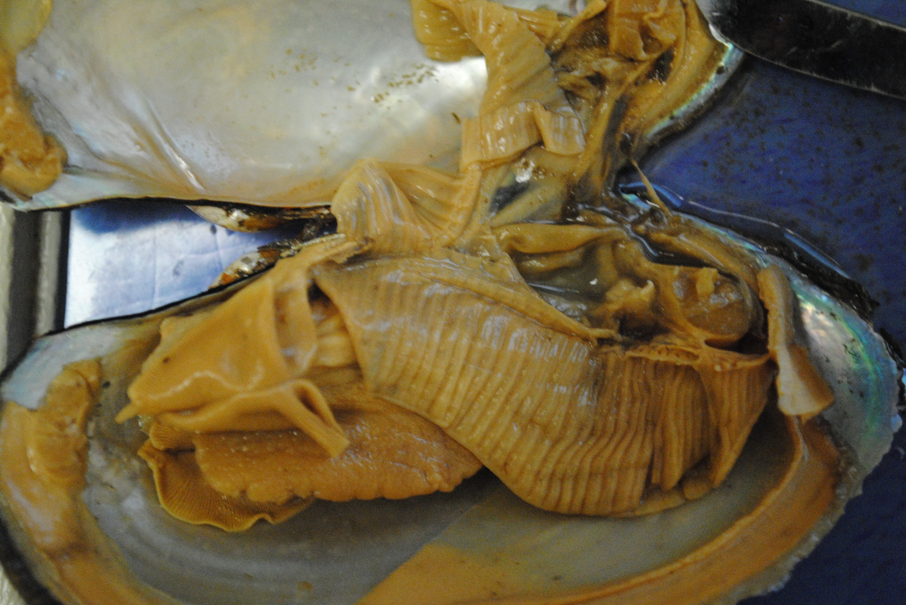
Stomach with intestine
Heart (mostly destroyed)
Labial Palps (stomach underneath)
Foot
Gills

Slide 3
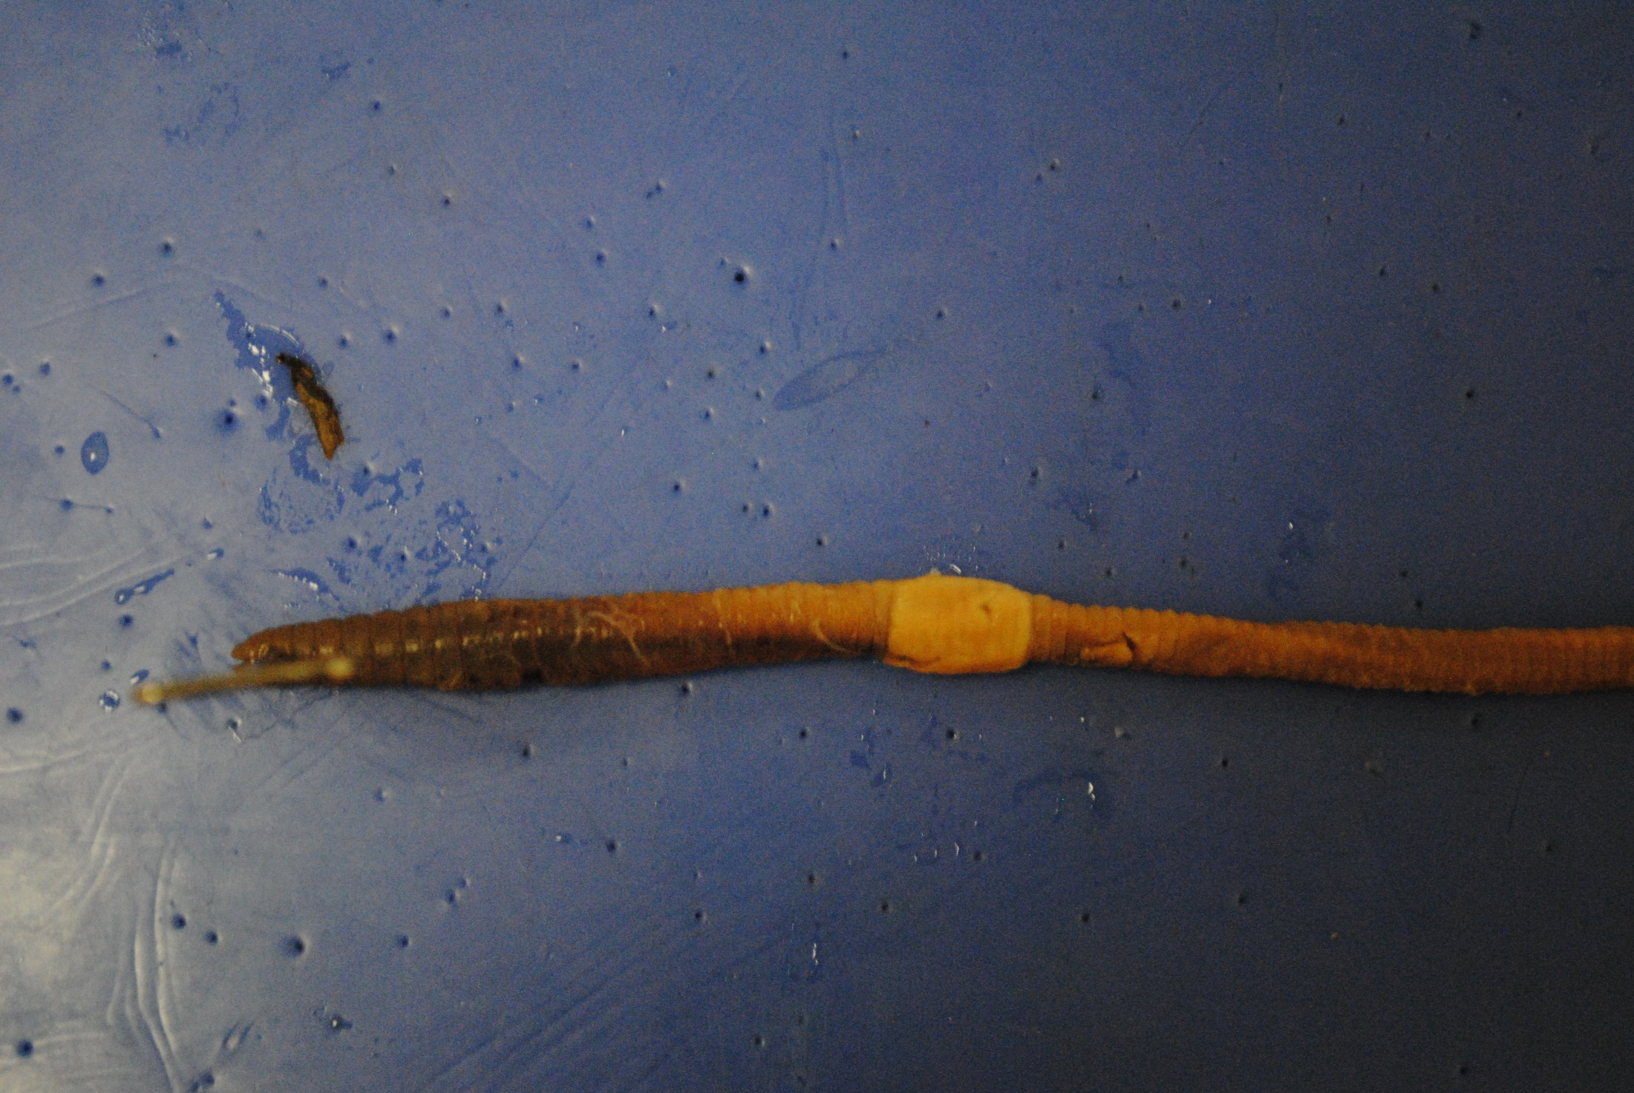
Seminal groove
Mouth
Clitellum

Slide 4
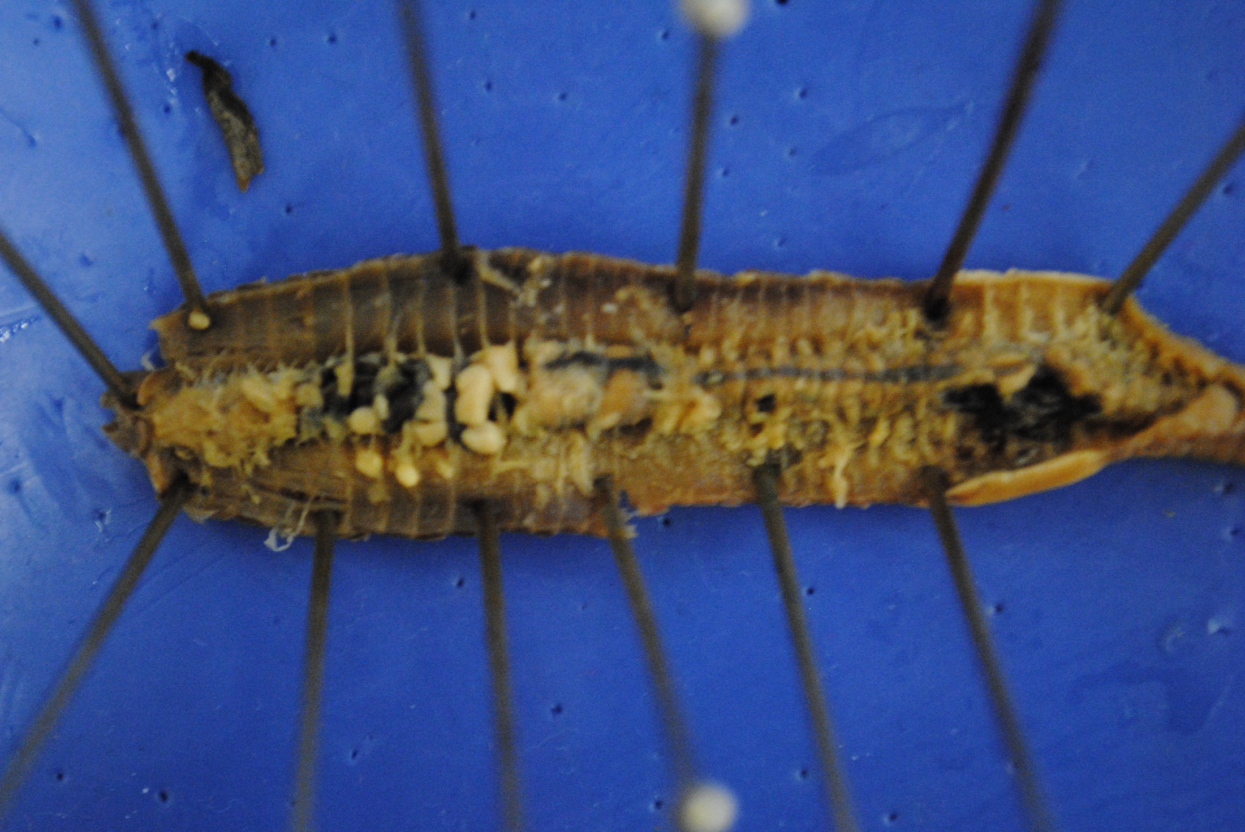
Hearts over esophagus
Seminal vesicles
Crop
Intestine
Brain
Septa
Gizzard
Pharynx
Seminal receptacles

Slide 5
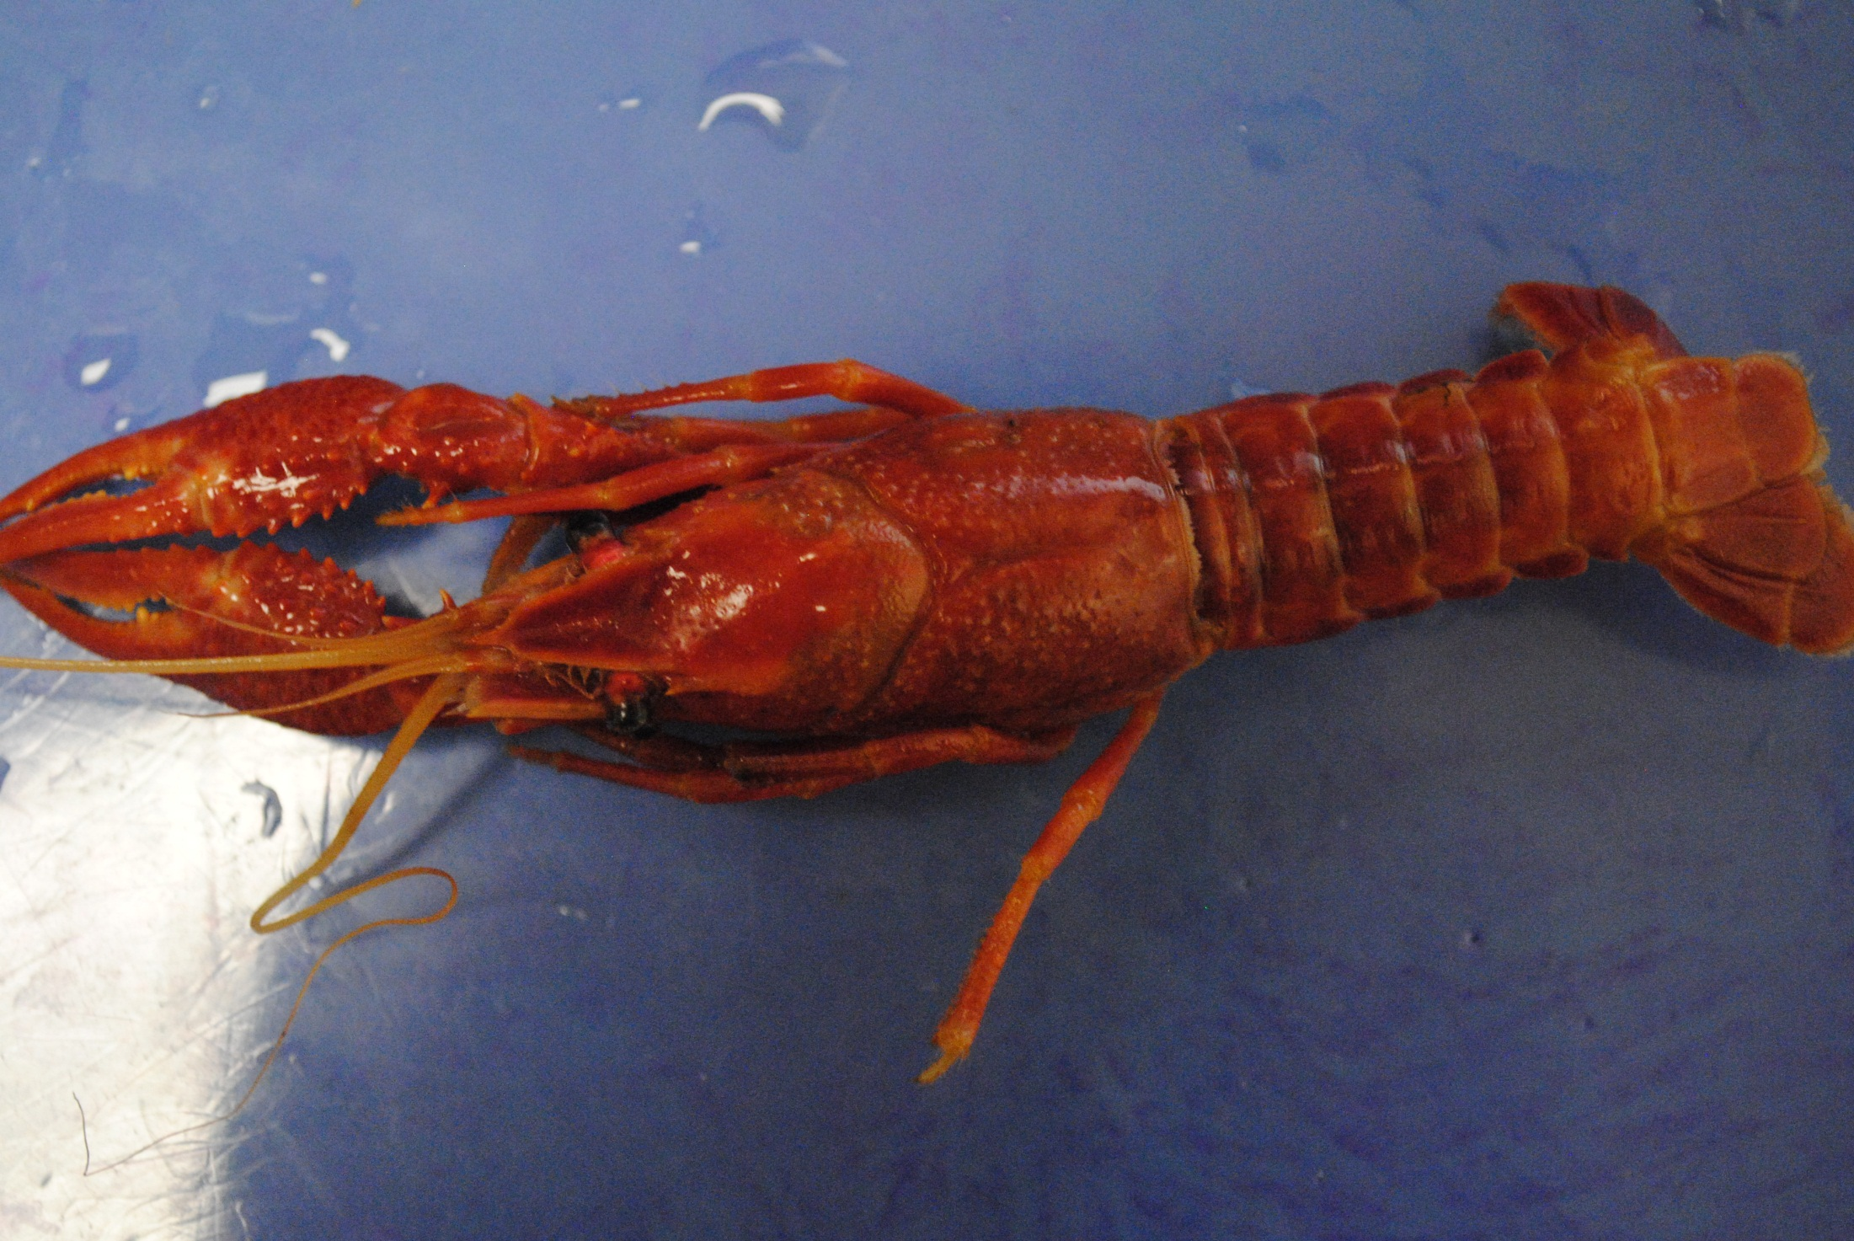
Telson
Claw
Rostrum
Uropod
Antenna
Eye

Slide 6
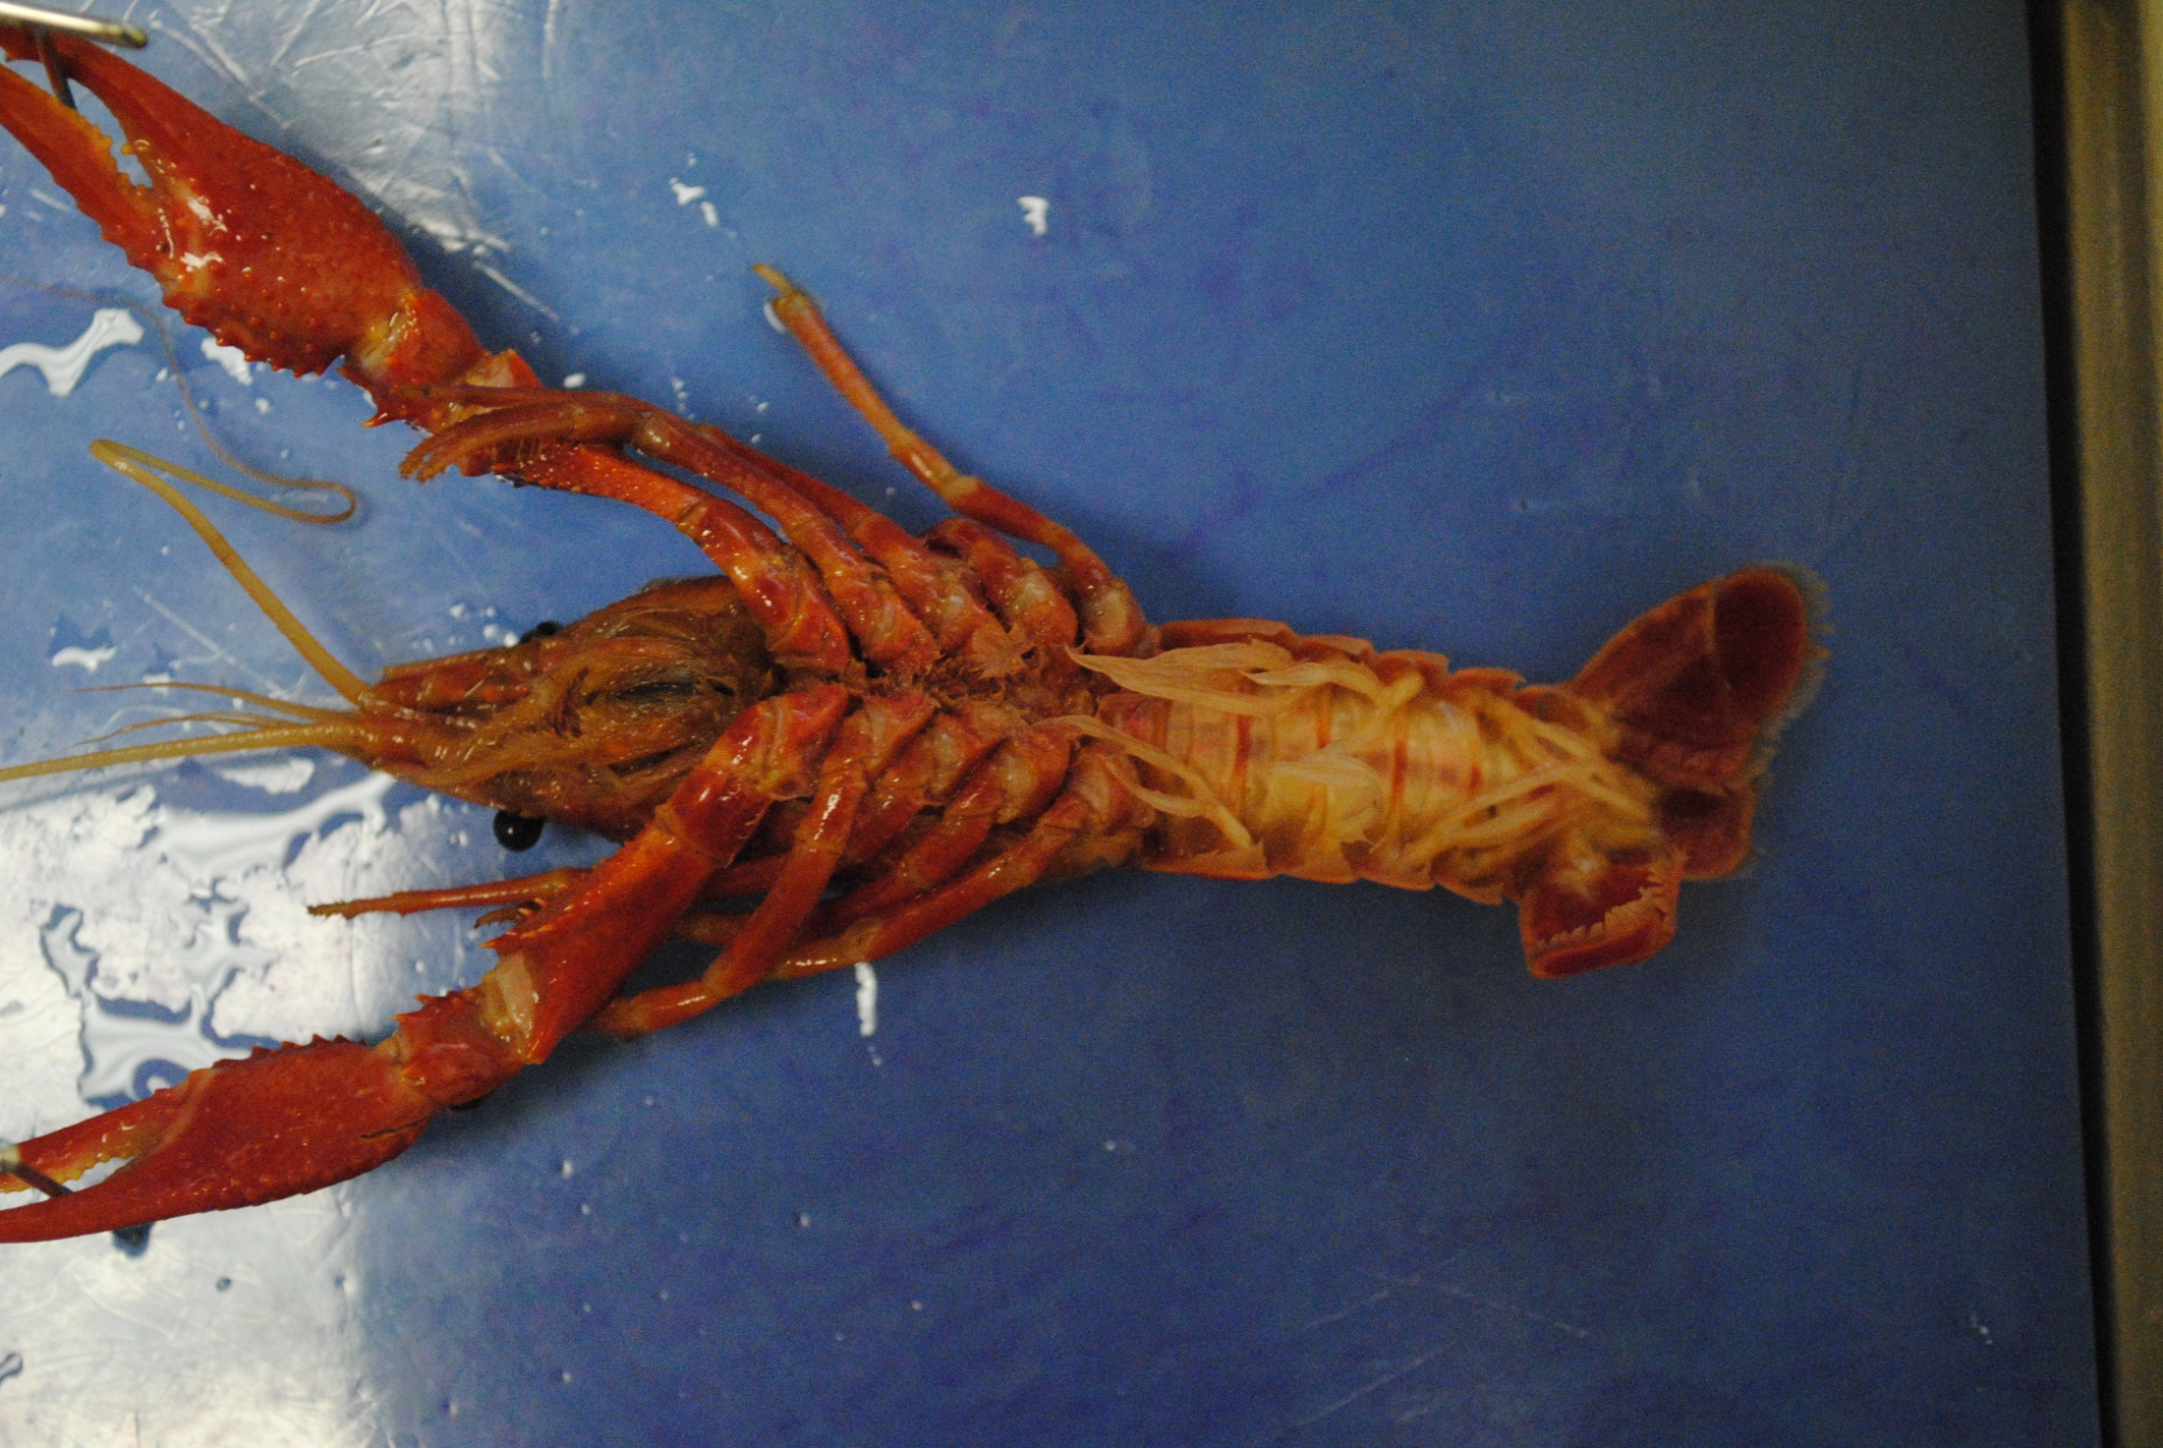
Uropod
Mouth
Swimmerets
v
v

Slide 7
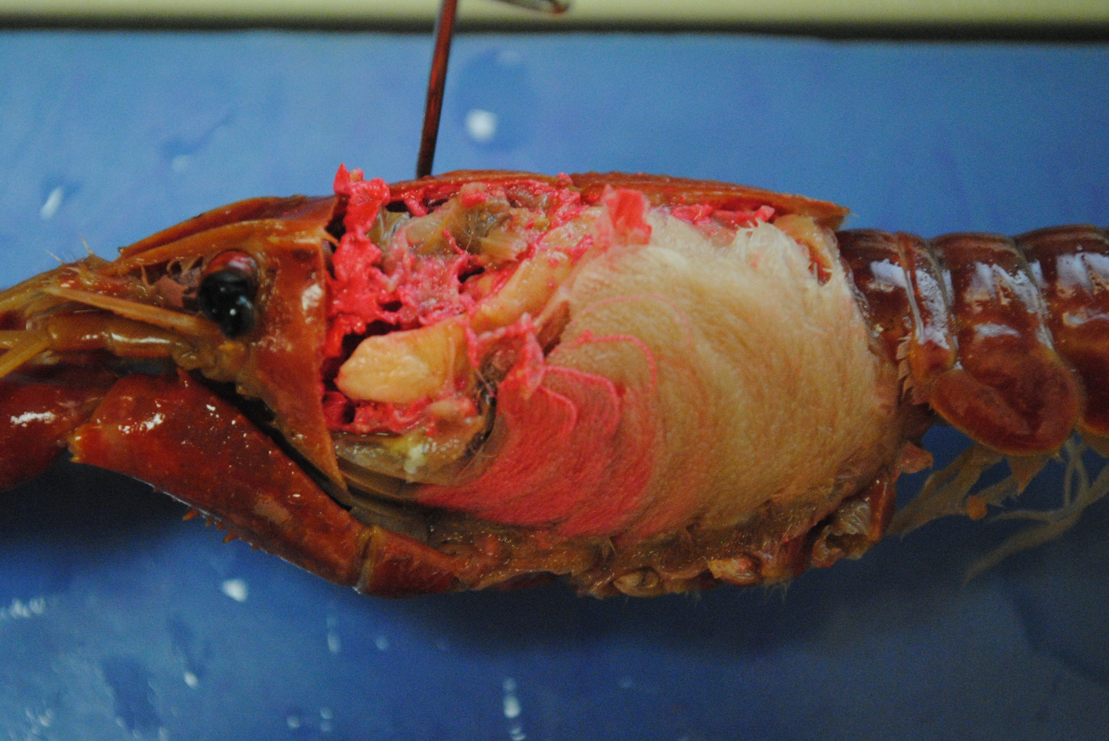
Heart (on top)
Stomach
Liver
Gills
Green Gland

Slide 8
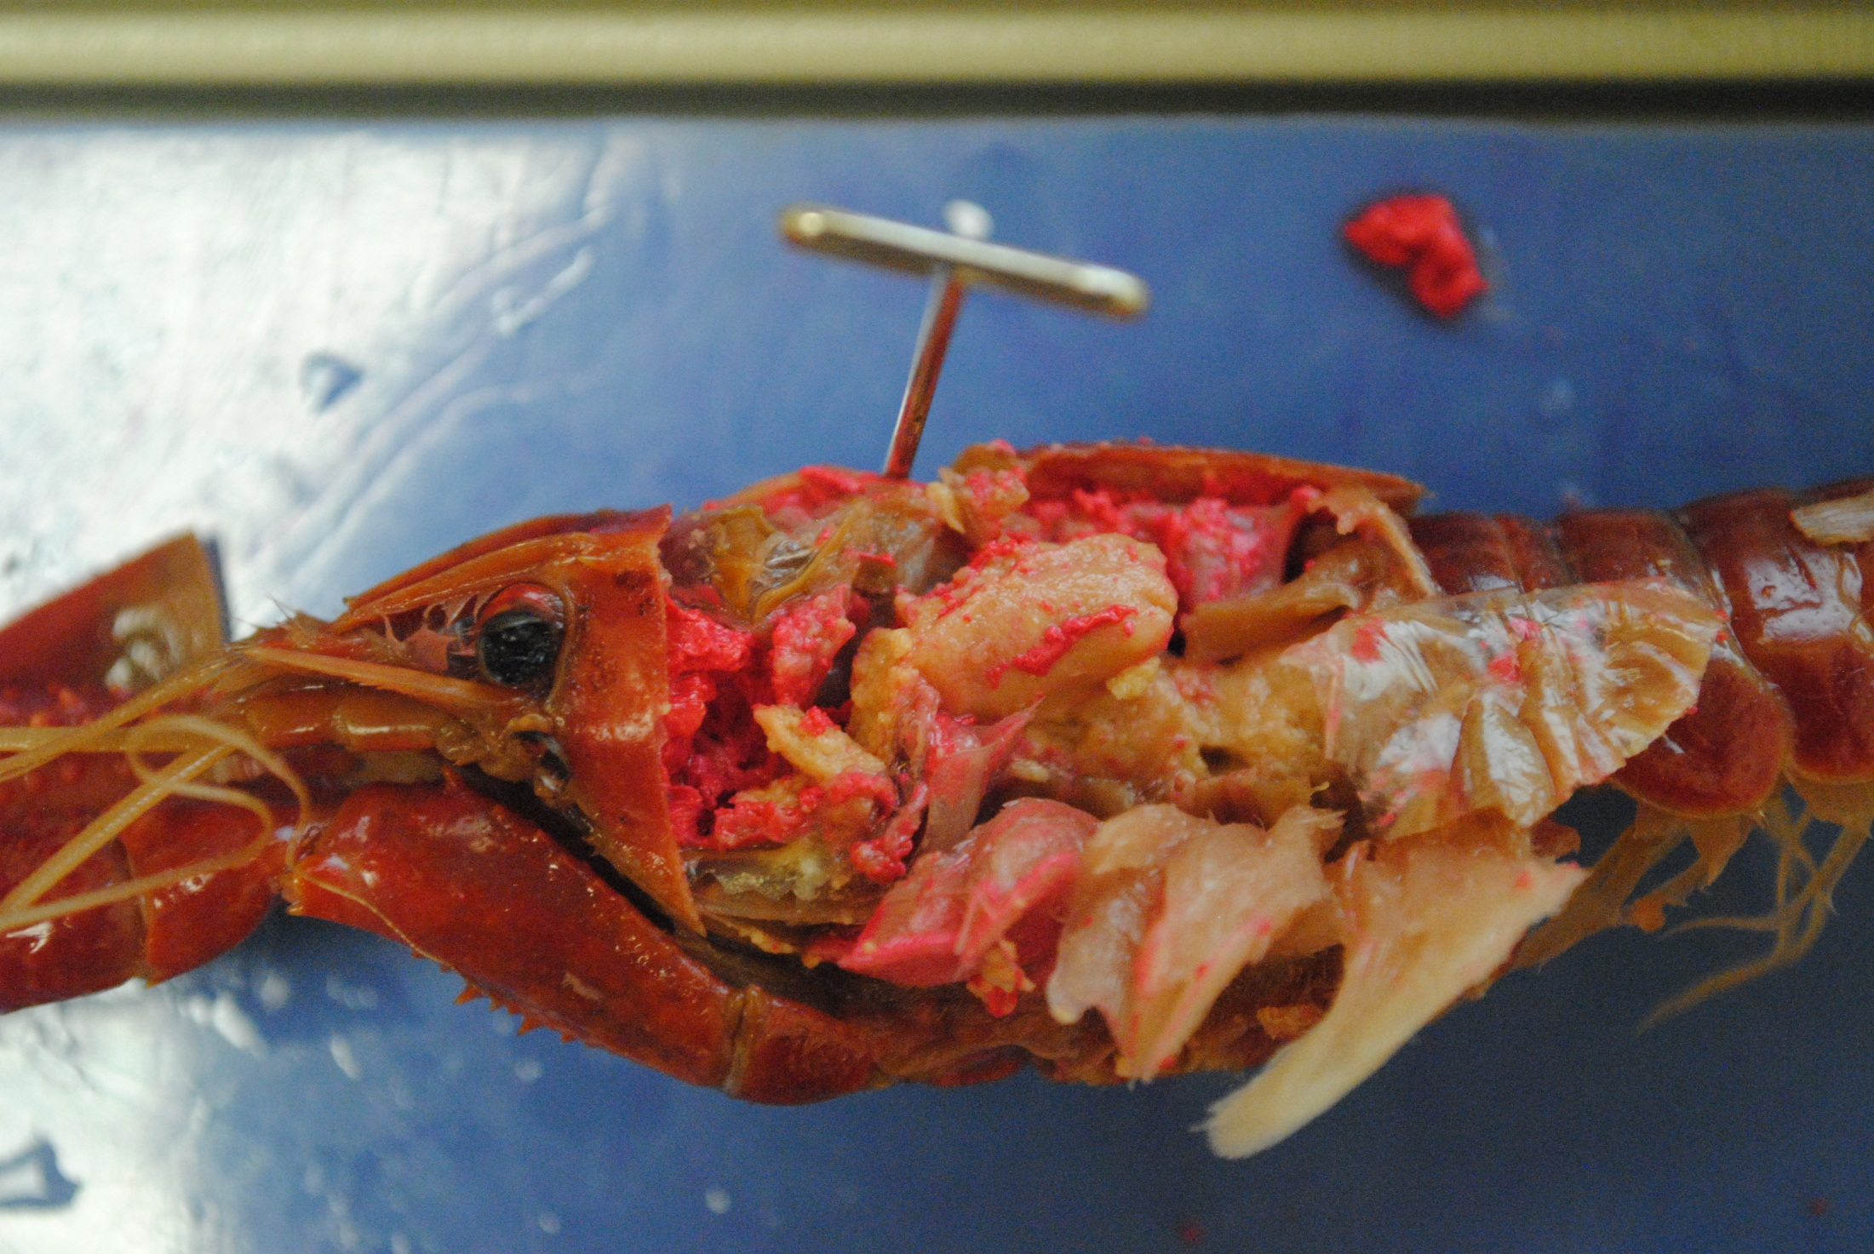
Stomach
Liver
Gills

Slide 9
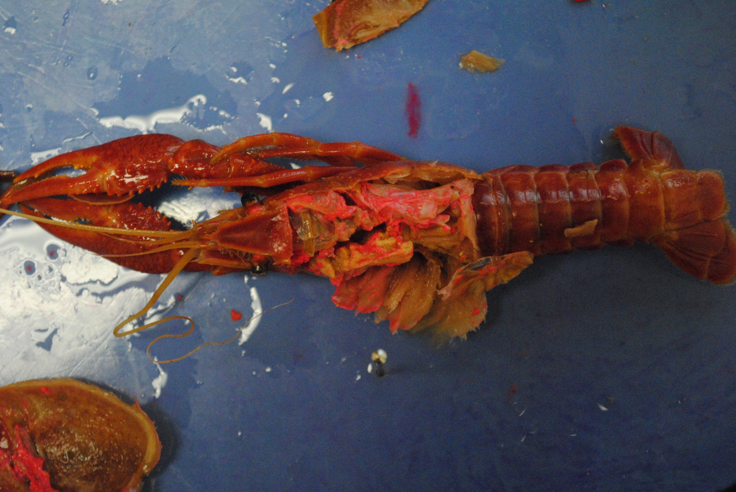
Heart
Stomach

