Slide 1
Number Line
Positive #
Negative #
Origin

Slide 2
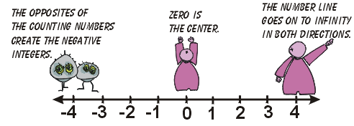
Number Line

Slide 3
Example: Locate & label the points on the real number line associated with the numbers -2.5, +2.5, 3/4
-2.5
3/4
+2.5
-3
-2
-1
0
1
2
3

Slide 4
Note: As we move to the right on a number line, the numbers increase. If two numbers are graphed on a number line, the larger one is on the right
-3
-2
-1
-3
-2
-1
0
1
2
3
-2
-3
-2
<
-1
>

